Slide 1
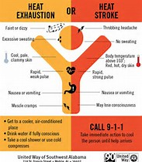
HEAT, HOT, HEY, HO!
Good timing to talk about heat injury prevention!
The Win VA plant has shared a “Heat Guideline” as a best practice SOP.
Portal >Safety Procedures & Training > First Aid & BBP

Slide 2
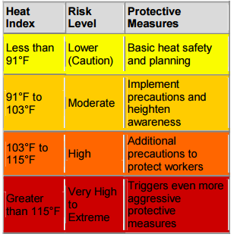
SOP Heat Guideline
Be familiar with the heat index and what corresponding steps to take.
Use a heat stress thermometer.
Provide potable water supply
with Gatorade packets.
Identify a cool area to retreat to.
Consider external cooling devices
Ex: Cooling bandanas, vests, etc.

Slide 3
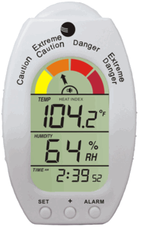
AMBIENT WEATHER WS-HE01 HANDHELD HEAT STRESS INDEX
WITH DEW POINT MONITOR, TEMPERATURE & HUMIDITY
Approximately $30.00 each
Emits audible warning sounds before heat index reaches critical levels.
Remember, heat related illness can be prevented by following the fundamental recommendations > stay hydrated; communicate; be aware of how you feel; and establish a work/rest regime.

Slide 4
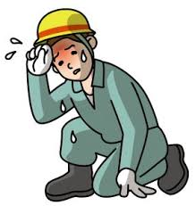
HEAT INJURY PREVENTION TIPS
DID YOU KNOW….
Over exertion in the heat can lead to Heat Cramps, Heat Exhaustion and finally HEAT STROKE. We say “finally” because HEAT STROKE can KILL you. If you feel that you are getting overcome by a heat related issue ask for help!
WHAT TO WATCH FOR…
Feeling weak, dizzy or lightheaded.
Have a headache, rapid heart beat.
Feel feverish, heating up, dry skin.
Get out of the heat, drink water, stay in a cool area.
Avoid caffeine. Do NOT drink alcohol.
LET’S THINK SAFETY + ACT SAFELY EVERY DAY!

Slide 5
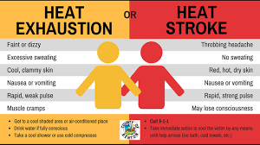

Slide 6
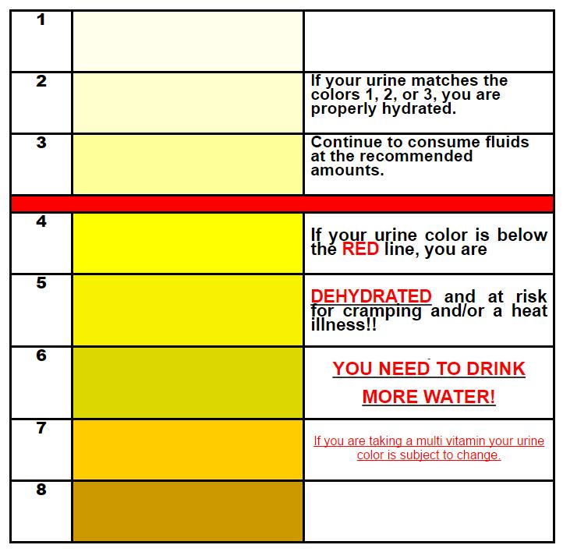
Urine Color Chart
The following Dehydration Urine Color Chart will help you use your urine color as an indicator of your level of dehydration and what actions you should take to help return your body back to a normal level of hydration.
If your urine color is 4-5, you should drink a little water (1/4 liter) over the next hour or two
If your urine color is 6-7, you should drink ¼ liter of water right now.
If your urine is 8 or darker, drink two bottles of water right now. If your urine is darker than this and /or brown or red, then dehydration may not be your problem. Please consult your doctor.
Are You Hydrated Enough?

Slide 7
