Slide 2
What is New, Now, and Next for Dairy?
President’s Breakfast
Sponsored by:

Slide 3
Michael Dykes, D.V.M.
President and CEO International Dairy Foods Association

Slide 4
Welcome to Dairy Forum 2022!
Notes:
I am grateful to be back together with you!
Dairy Industry Premier Event!
What makes it so meaningful to so many – Personal Connections
I have been a part of the dairy industry in one way or another most of my life. Good people at the center never change.
Take time to appreciate the personal connections we form at Dairy Forum. Our relationships become more important to us each and every day!

Slide 5
Notes:
We have a tremendous program planned for you to discover the things that are NEW, NOW and NEXT for dairy!
We have industry analysts, Policymakers, professors, federal officials, experts in global commerce and trade, innovators, premier industry consultants.
Many topics – Sustainability, Health and Wellness, Supply Chain, People and yes FMMO
New panel this Forum – Our IDFA VP will lead a panel discussion with our International Dairy Leaders for Global perspective.
McKinsey present their broad industry perspective on the CPG sector with specific input from our Dairy Industry Leaders.
I want each of you to walk out of this Forum with at least one thing you plan to take home and use in your business.

Slide 6
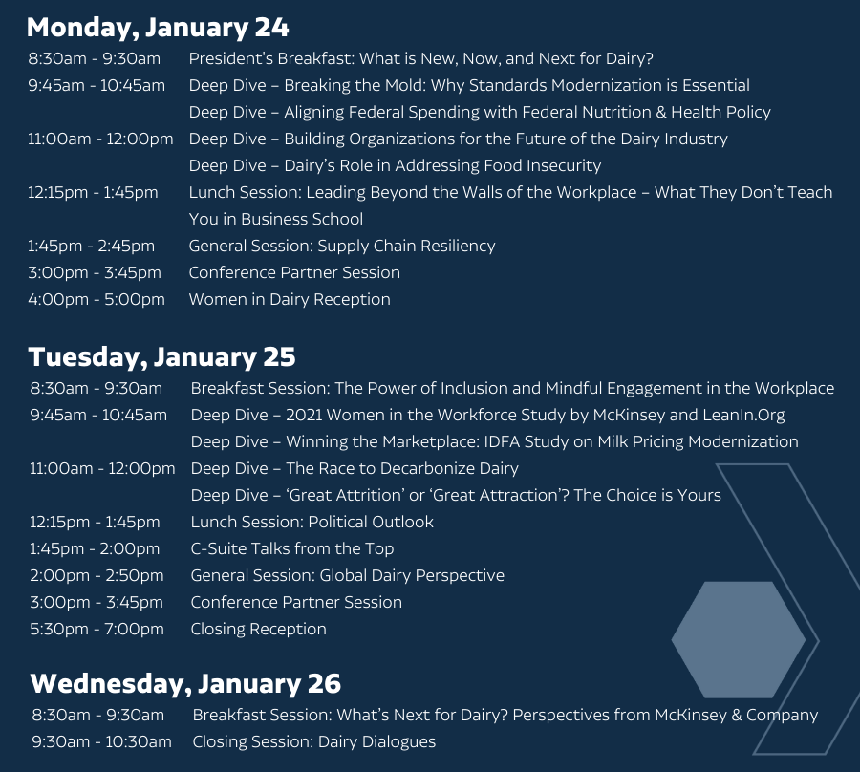

Slide 7
Big Questions to Answer
What will it take to position our industry to win the future?
What pricing model will make us competitive and support growth?
What does leading with sustainability require for our industry?
How do we keep dairy included in the healthy foods category?
How do we encourage more innovation?
How do we attract and retain the best people?
Notes:
I believe that our US dairy industry is poised to become the world's dominant supplier of dairy products and all of you are going to make that happen but we have some big questions to answer
I will use the themes of NEW, NOW, NEXT to address these and more.

Slide 8
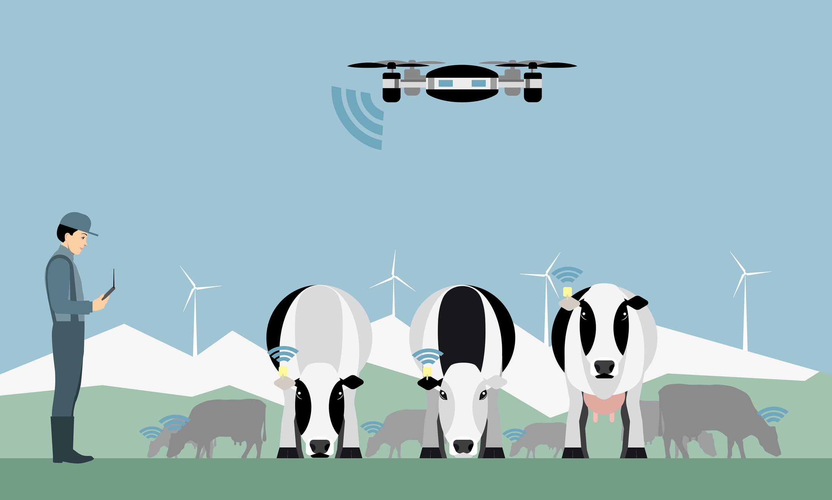
We’re Doing NEW Things
Notes:
Our industry is changing and changing rapidly.
If you have not been on a farm in the last 5 years.....you are out of touch with today's farms. Technology, data, genetics...all are simply amazing!

Slide 9
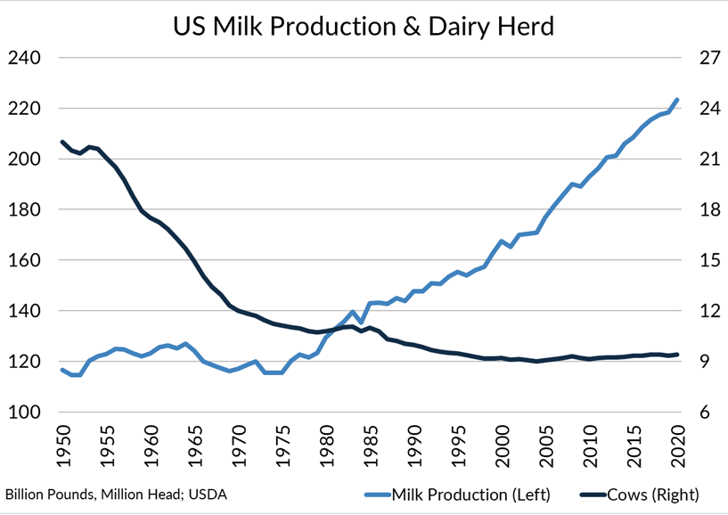
Incredible Efficiency
Notes:
Our dairy farmers are producing twice as much milk today vs 70 years ago with half as much milk and each glass of milk today has a carbon footprint that is reduced to 2/3 smaller today than 70 years ago. All as a result of efficiency!

Slide 10
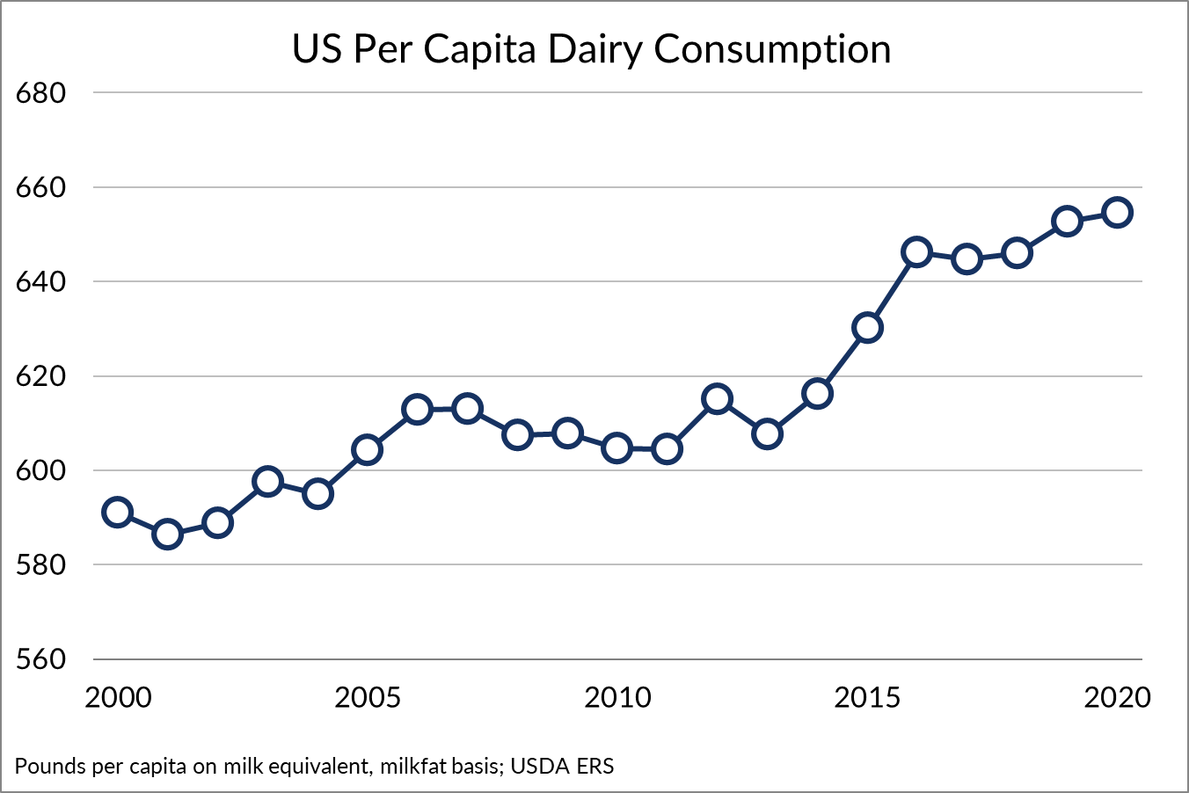
Demand Is Up
Notes:
Dairy Demand is UP and it is continuing to go UP! So much of the time people, especially reporters, want to talk with me about the decline of dairy. Often this is based on the fact that fluid milk sales are declining but overall Dairy Consumption is up 3 # person last year. We are eating more of our dairy!

Slide 11
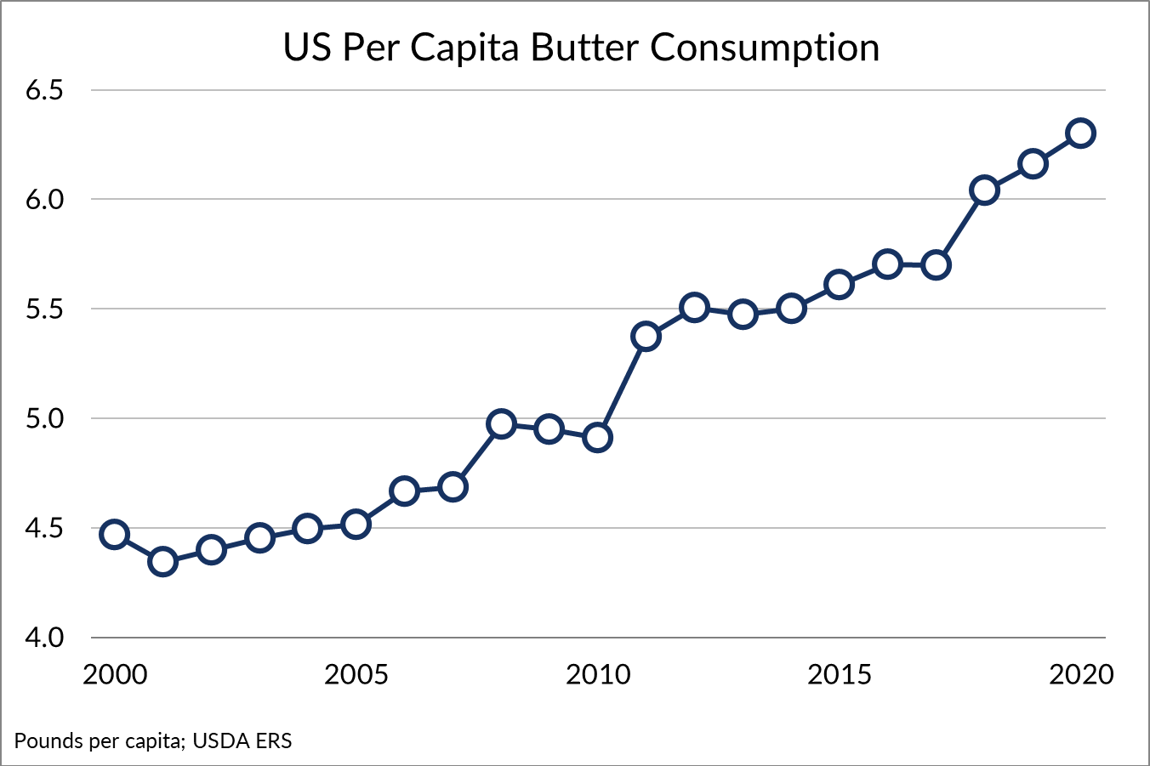
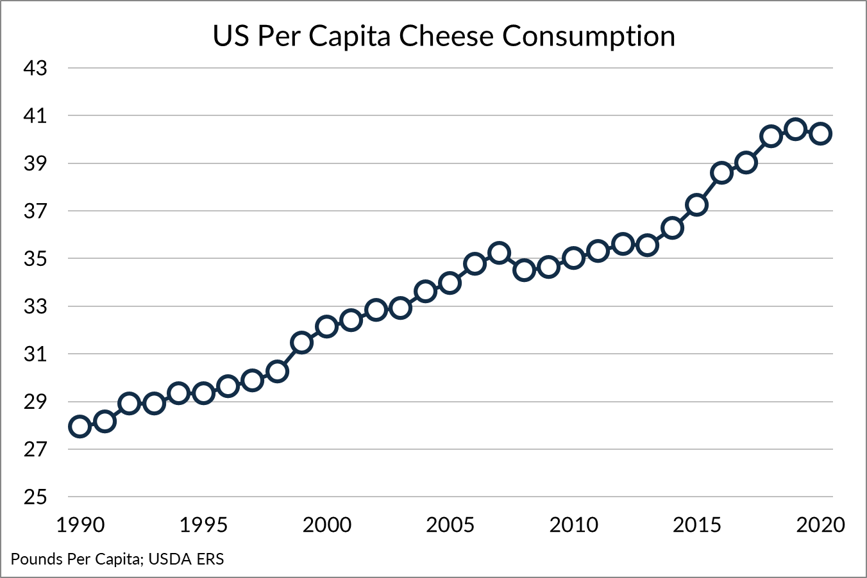
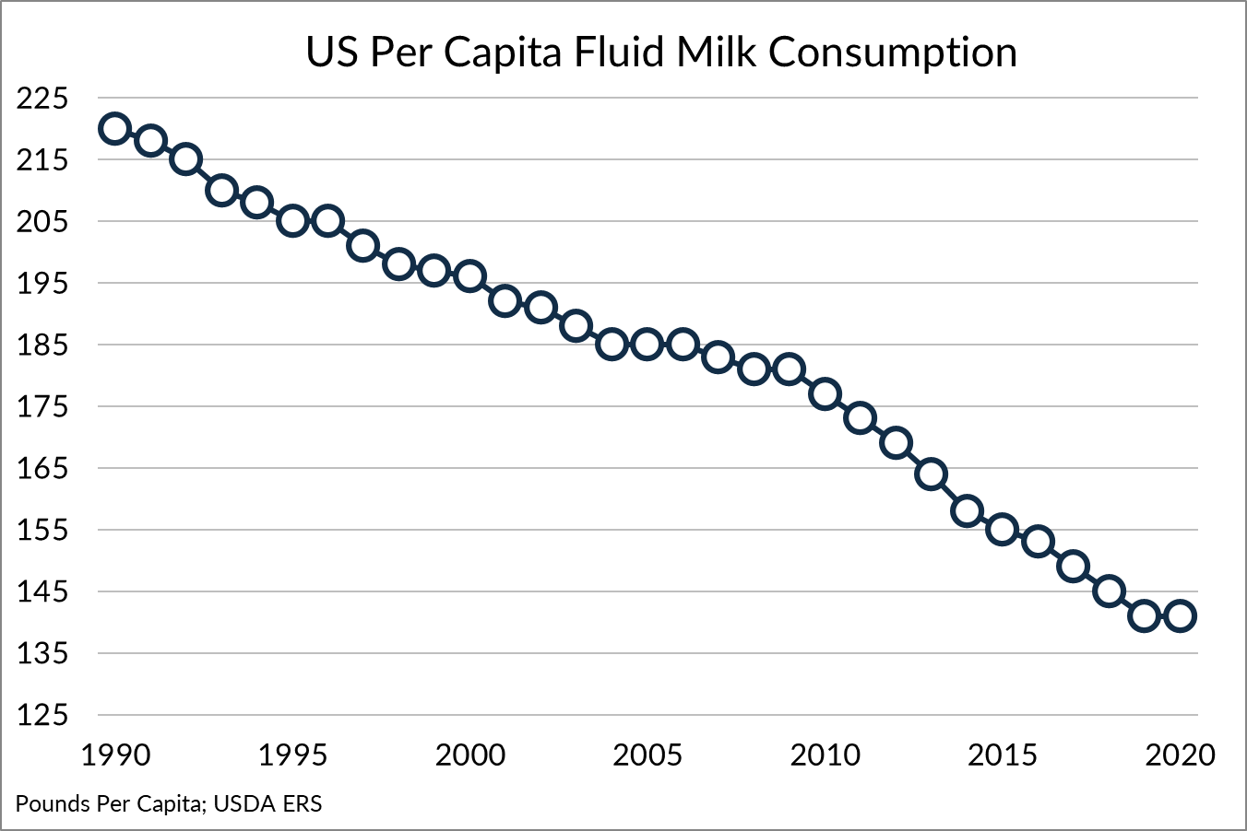
We’re Eating More Than We Drink

Slide 12
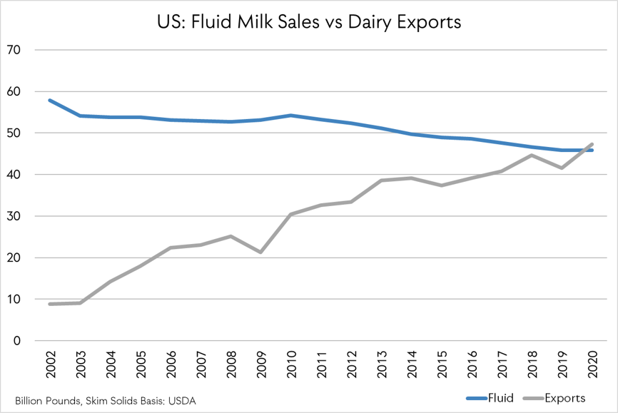
And Exporting More Than We Drink

Slide 13
Innovation
Notes:
Innovation is not just at the farm level. It is everywhere, and it is coming faster all the time.

Slide 14
NEW Investments Across the Industry
MWC Plant, Michigan – DFA, Glanbia, Select Milk Producers
State of the Art Cheese, Whey Plant – 260 Jobs
California Dairies Inc., CA – Valley Natural Beverages Plant
UHT and Innovative Fluid Products – 100 Jobs
Leprino Foods, Texas
Mozzarella & Dairy Ingredients – 600 Jobs
Great Lakes Cheese, NY
Premier Manufacturing & Packaging Facility – 400+ Jobs
Kroger & Ocado, Ohio
‘The Hive’ Fulfillment Center – 400+ Jobs (plus 1,000 bots)
Notes:
$2 billion over the past 2 years and another $2 billion in the next 3 years
This is only a partial list of investments
Kroger – Huge 3 D grids, the HIVE, to fulfill orders managed by a proprietary air traffic control system
We are a job creating industry Nearly 2000 jobs only in this list of investments which is not nearly all investments. More workforce issues on the horizon

Slide 15
Embracing NEW Actions
Notes:
This past year has brought out the best of everyone in our industry to manage the "black swan' event of COVID!
Forced us to embrace new actions, quickly and in ways we never thought possible.
Highlighted the value of our work on our IDFA Vision for the Future

Slide 16
IDFA Vision for the Future Task Force
Courtney Bidney, General Mills
Philippe Caradec, Danone North America
Patrick Carroll, IMA Dairy & Food USA
Carmine C. Catalana, IV, Cumberland Dairy, Dairy Farmers of America, Inc
Joe Diglio, Michigan Milk Producers Association
Heather Draper, The Ice Cream Club, Inc.
Rich Draper, The Ice Cream Club, Inc.
Kurt Epprecht, Great Lakes Cheese Co., Inc.
Miriam Erickson Brown, Anderson Erickson Dairy Company
Ted Jacoby III, T.C. Jacoby & Company, Inc.
Brian Perry, Perry’s Ice Cream Company, Inc.
Jorge Ramos, LALA U.S.
Yin Woon Rani, Milk Processor Education Program (MilkPEP)
Caleb Robinson, Saputo Dairy Foods USA, LLC
Jim Sartori, Sartori Company
Neal Schuman, Schuman Cheese
Scott Sexton, Dairy.com
Sue Taylor, Leprino Foods Company
Mike Wells, Wells Enterprises, Inc.
Dan LaMarche, Vice President, Operations, Agropur U.S.
Patrick Criteser, Tillamook County Creamery Association
Tim Hopkins, Turkey Hill Dairy, Inc.

Slide 17
Vision for the Future Scenarios
Scenario 1. Dairy Consumption Declines After Decades of Gains
Scenario 2. Alternatives Become the Conventional
Scenario 3. Local Is the New Global
Scenario 4. Channel-Driven Disruption
Scenario 5. A Green New Future
Scenario 6. Wellness-Driven Growth
Scenario 7. Growth Driven by Premium Products
Notes:
Presented these 7 scenarios to our Boards for review .
To touch on few of these
#1 We lose on the health and wellness efforts,
#3 Trade declines, no new Trade agreements, climate change forces restrictions on imports, Geopolitical China or Russia
#5 Will depend on how well we manage the sustainabiity movement
#6 Dairy is seen as key to health and wellness
#7 Indulgence and Category Premiumization
Identified no regret moves and big bold moves to influence our industry toward a positive future.
Added new priorities on our 5 Segment Boards

Slide 18
Outcomes of Vision for the Future
Building a More Resilient, Flexible Supply Chain
Harnessing Technology & Innovation
Moving to a More Sustainable Dairy Industry
Attracting & Retaining the Best People
Notes:
Our work on our Vision for the Future highlighted new actions our industry must embrace as we continue to evolve

Slide 19
Building a More Resilient, Flexible Supply Chain
Notes:
Task Force Formed – both ports and land transportation
We have worked with Ports, USDA, WH, DOT and our leaders have been fully engaged.

Slide 20
Expertise in Supply Chain Resiliency
Notes:
Our work on our Vision for the Future highlighted new actions our industry must embrace as we continue to evolve
Port of LA, Port of Oakland, Gene is at Dairy Forum
CMA and Evergreen Carriers
Pilot Program

Slide 21
Moving to a More Sustainable Dairy Industry
Notes:
Proud of the great work our industry has done. The commitment of 75% of the milk supply to achieve a net zero by 2050.
Animal agriculture adds another level of complexity to our industry. Cows are machines that eat cellulose and turn it into nutritious dairy products and they produce methane in the process.
We also have to address the packaging and recycling as well.

Slide 22
Accountability Is Key
Track/Report Scope 1-3 Emissions
Understand On Farm Measurement
Sustainable Packaging Efforts, Design for Circularity
Safeguard Water Quality & Quantity
Aggressive Nutrient Management
More Renewable Energy, Less Non-Renewable Sources
Notes:
Our work on our Vision for the Future highlighted new actions our industry must embrace as we continue to evolve
Sustainability is moving to accountability and investments. It will function much like the current financial review and accountability in a P&L
We may see sustainability reported to the SEC , maybe in their annual 10k reports or another environmental risk disclosure.
BCG is estimated that the global supply chain will need to invest $100 trillion to meet the goal of net zero by 2050!
Scope 1 – your own direct emissions Scope 2 – Indirect from your own operation (power, water waste) Scope 3 – all other indirect MILK from the farm 90%
We are moving beyond "storytelling"

Slide 23
IDFA Sustainability Committee
To further the dairy industry’s ability to establish & meet its sustainability goals and targets
Notes:
Our work on our Vision for the Future highlighted new actions our industry must embrace as we continue to evolve
We want to work collaboratively
Sustainability focused trade agenda
Recycling policy at Federal and State levels

Slide 24
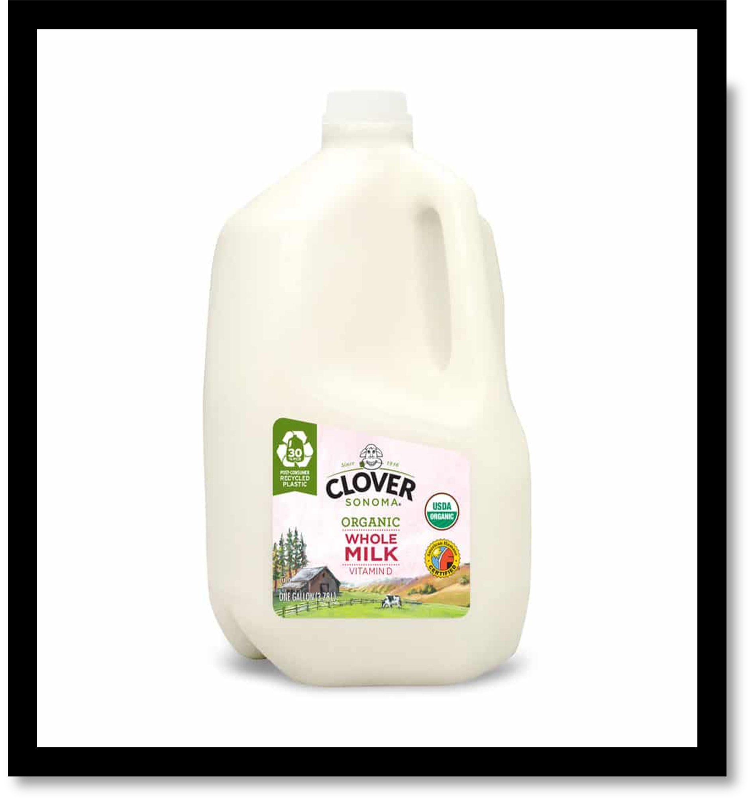
IDFA Packaging Position
To support a comprehensive and equitable federal extended producer responsibility (EPR) program that incentivizes end markets for post-consumer recycled-content (PCR) and ensures the availability of adequate food-grade plastic resins and other materials used in dairy product packaging.
Notes:
Our work on our Vision for the Future highlighted new actions our industry must embrace as we continue to evolve
Many states have passed new recycling laws. ME, WA, OR, CA NJ been very active
Questions of availability of PCR,
Questions about food safety and conflicting with PMO for fluid milk

Slide 25
Harnessing Technology & Innovation
Notes:
Technology has exploded during COVID and will continue to change all aspects of our lives
It will influence our sustainability efforts. New feeds for our animals to reduce GHG, New tools to measure GHG, Alternative energy sources,
With more technology will come more opportunities and more also new challenges

Slide 26
Dairy Is Embracing Digital Transformation
First, by driving new applications across the entire supply chain.
Second, more accountability and responsiveness to consumers and customers; and with that comes greater vulnerability in cyber security.
Notes:
Dairy is not unique and we are embracing Digital Transformation
There are many, many applications across the supply chain. Digitalizing shipping containers so they can be tracked, Automation in our facilities
It is also gives us more accountability and makes us far more responsive to our customers and consumers. We can know more about their habits, their desires
And this also increases our vulnerability to Cyber Security

Slide 27
Mitigating & Neutralizing Cyber Threats
Training and Education
University of Minnesota, McKinsey, & more
Conferences & Events
Introducing DairyTech
Community of Experts
Join the new Dairy Tech & Innovation Network
Notes:
Training and Education
Webinar Series hosted by University of Minnesota Food Protection and Defense Institute, McKinsey and Associates, & More
Conferences and Events
Introducing The DairyTech Conference, May 18-19, 2022, Austin, TX
Community of Experts
Introducing a New IDFA Community: The Dairy Tech and Innovation Network

Slide 28
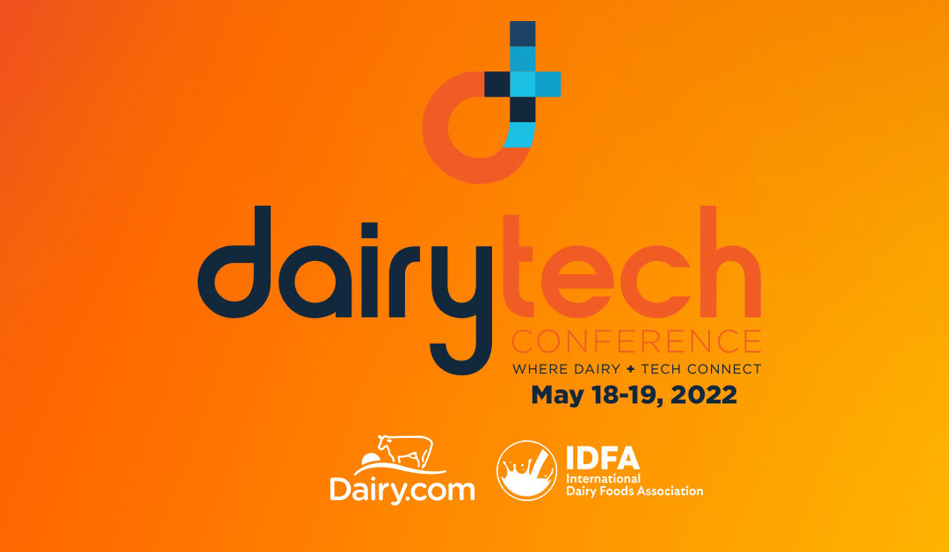
Visit www.dairytechconference.com to Register Today!
Notes:
We plan to focus on the opportunities of digital transformation in the dairy industry at this new conference.
We are calling it the place where Dairy and Tech Connect!
May 18-19 in Austin Texas in conjunction with our Spring Board meetings!

Slide 29
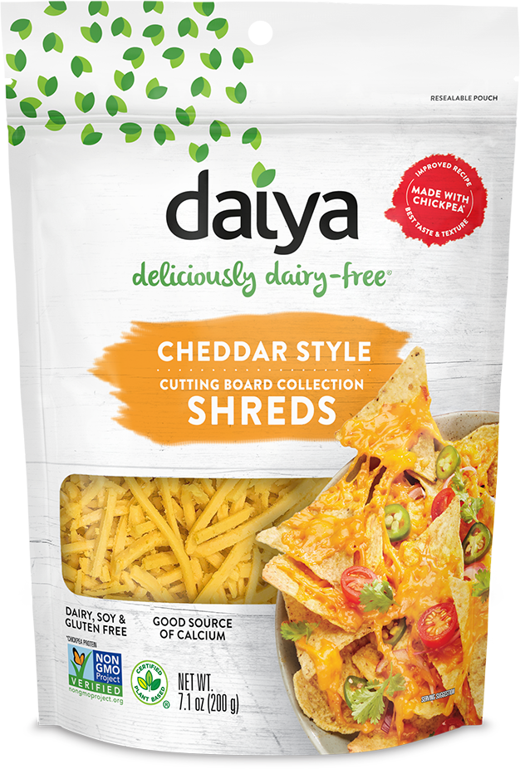
NEW Technology – NEW Products
IDFA Has Convened Board-Level Steering Group & a Working Group
Safety, Transparency & Consumer Understanding Will Influence FDA Policy & Vice Versa
Notes:
Cellular Ag
Animal-Free Dairy
Tremendous amount of capital on the sidelines to invest in new technology.
Global markets retuned 18% in 2021, S&P returned 29%. Created $1.2 trillion in excess consumer savings. There is a lot of wealth to invest and to spend. Goldman Sachs has estimated $4.7 trillion.

Slide 30
Attracting & Retaining the Best People
Notes:
Such an important topic.
Proud of IDFA’s work on this important issue over the past 3 years!
People was a key point coming out of our Vision for the Future.
We will continue our focus on this issue!
As our industry is embracing Digital Transformation, we are focusing on Attracting and Retaining the Very Best People!

Slide 31
IDFA People Strategy
Notes:
Our IDFA People Strategy has 5 components. We are currently considering adding new components.
Member interests in these continues to grow!

Slide 32
Women in Dairy
Empower & support women
Leadership, mentoring & networking
600+ members
Join today!
Notes:
The reviews on this program have been fantastic.
We are very appreciative of our Advisory Committee! True partners in empowering and supporting other women.
Over 600 and growing!

Slide 33
NextGen Leadership Program
Mid- to senior-level professionals
75 in first three cohorts
Cohort 4 in Spring 2022
Interested? Contact us!
Notes:
We have 3 classes totaling 75 Next Generation of Dairy Leaders.
Such an impressive group of individuals. They are already taking on new leadership roles and providing valuable input on our various committees and task forces.
Please stand to be recognized. Make sure you introduce yourself to these next leaders!

Slide 34
HR Leaders in Dairy
Community for CHROs
Share knowledge & experiences
50+ professionals
Open enrollment
Join today!
Notes:
I enjoy all our Boards, Task Forces and Networks but I have to admit that I look forward to the monthly meetings of these CHROs!
They are on the cutting edge of the exploding number of people related issues, from attracting and retaining to managing all the many COVID requirements, to CDC, OSHA, SCOTUS, PTO, Schools, Childcare, healthcare, on and on. You name it and these people are implementing plans to manage all these issues!
What a remarkable group of individuals! So welling to share with one another to help each other. Wonderful to witness

Slide 35
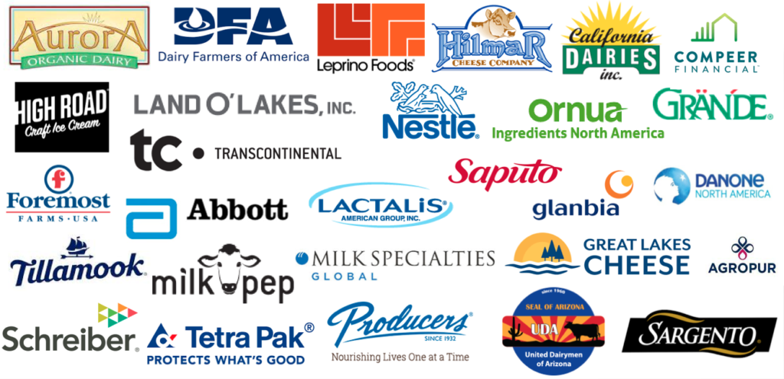
Dairy Diversity Coalition
28 companies involved
Increasing diversity, equity & inclusion
Building workforce reflective of communities we serve
Interested? Contact us!
Notes:
McKinsey analysis top 25% for gender diversity on executive teams are more likely to have above average profitability!
We have worked in close partnership with Egon Zehnder and McKinsey on this effort!
Again our members are engaged and supportive.
Come join us!

Slide 36
Power of People Conference
Coming October 4-5, 2022!
For CHROs & CEOs
Learn new strategies to address workforce & organizational challenges
Notes:
We are putting People at the center of everything we do.
We plan to bring CEOs and CHROs together Oct 4-5 Amelia Island Florida. In conjunction with our Fall Board meeting!
We will discuss the many people issues as well as organizational effectiveness to take advantage of a changing and dynamic marketplace.

Slide 37
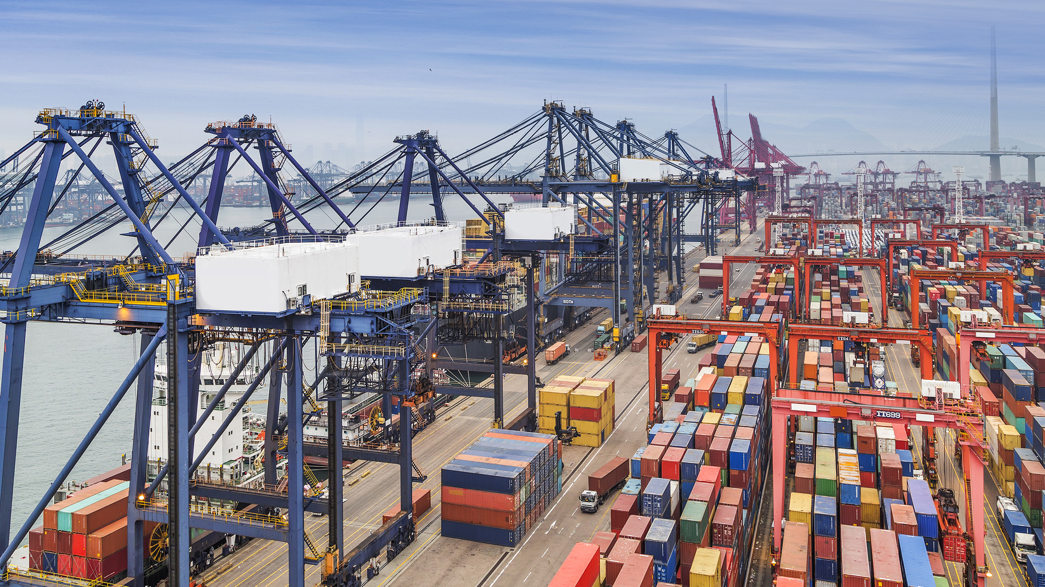
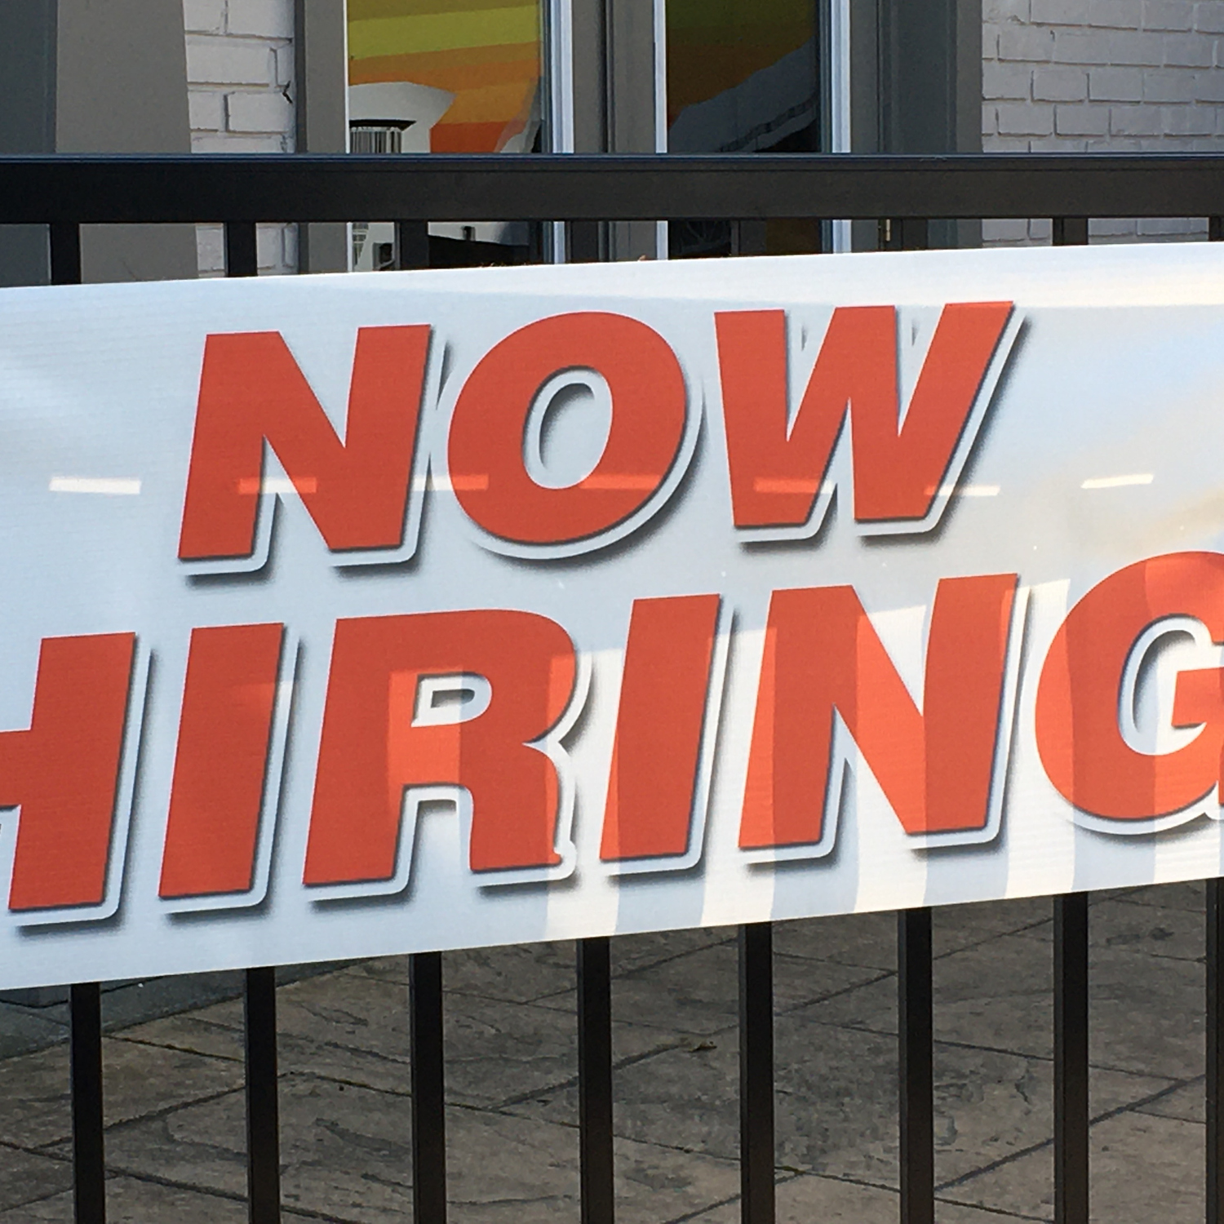
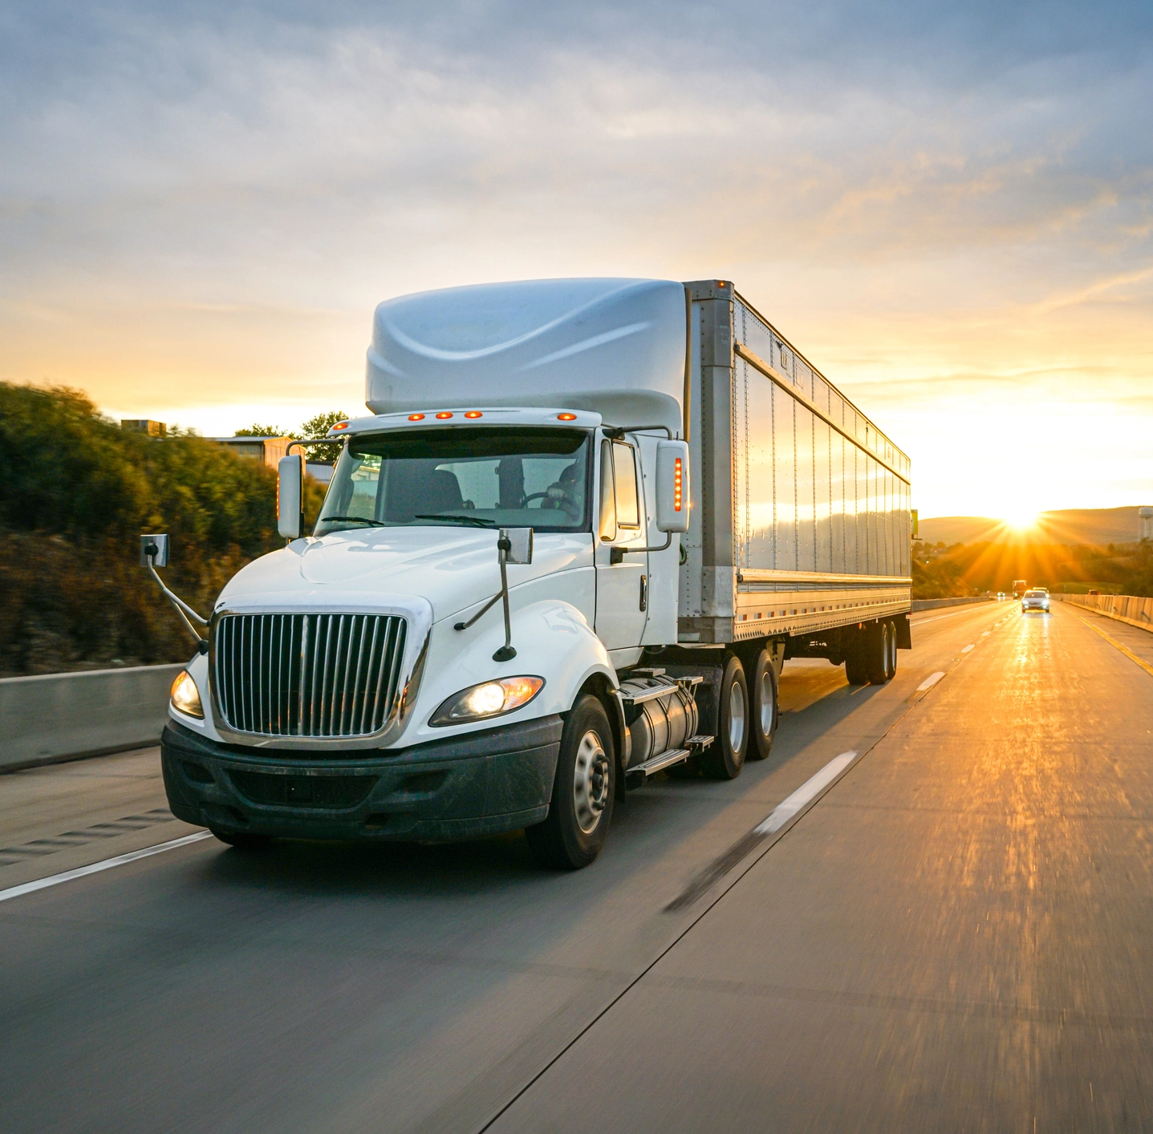
The Challenges of NOW
Notes:
I have covered the what is NEW in our industry.
So now lets look at the things that are NOW!

Slide 38
Workforce: Challenges Persist
Notes:
NOW is about one word……WORKFORCE!
Every member conversation is related to workforce. Yes demand is up and that is great but I need more workers.
We talk about this challenge at every CHRO meeting.
The milk keeps coming, the demand is growing and we are struggling to have the workers to meet this demand. Truck drivers and maintenance workers top the list in terms of most difficult positions to fill! A CDL is harder to hire today than PhD!
McKinsey will present a session here at Dairy Forum on the Great Attrition or Great Attraction….The Choice is yours. I encourage you to attend this session but let me warn you, it will require some of you to change you approach to PEOPLE!

Slide 39
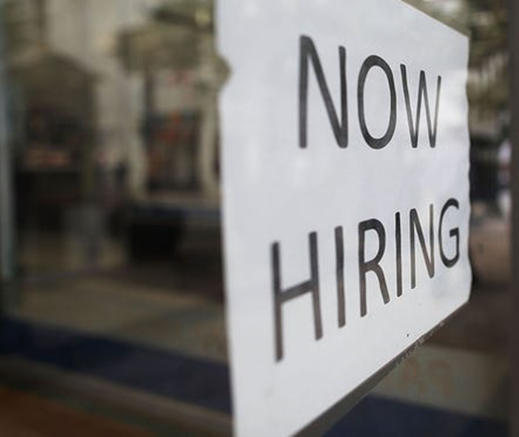
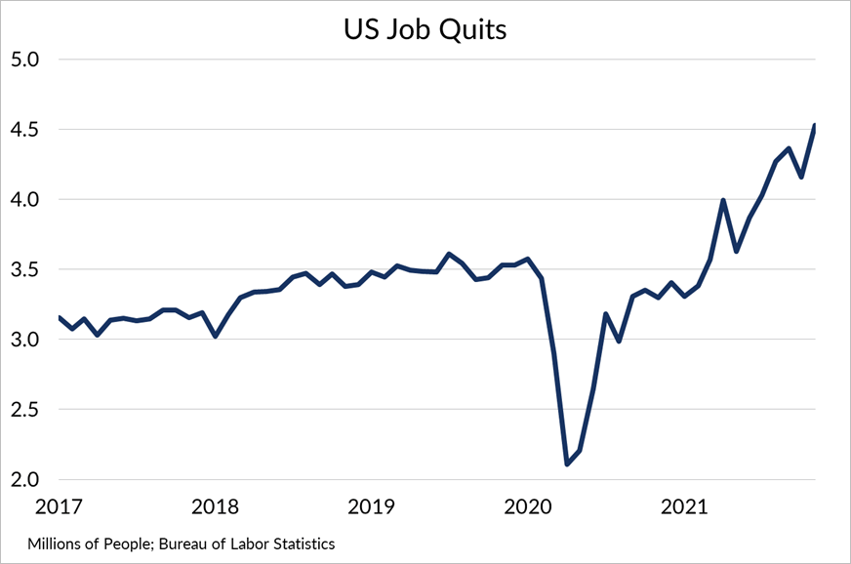
The Great Attrition …
Notes:
Over 38 million quit their jobs in 2021
4.2 million quit in October
4.5 million quit in November

Slide 40
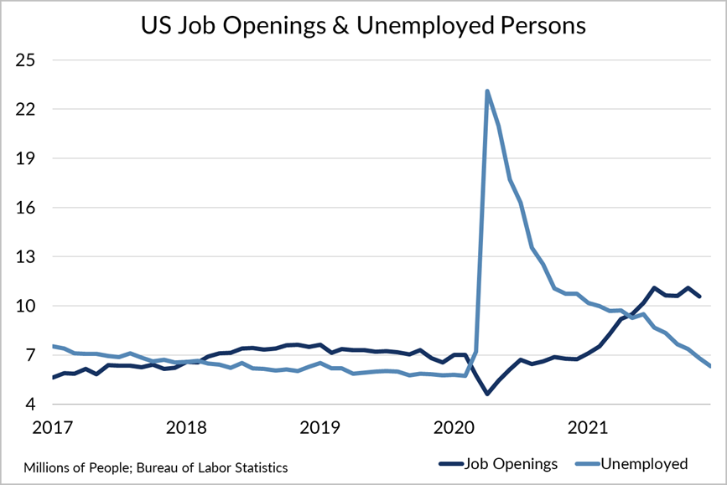
The Great Attraction
Notes:
There were 10.6 million job openings and roughly 7 million unemployed people.

Slide 41
“It feels like we’re walking a tightrope.”
Notes:
On the one hand:
Wages rising
Demand up across category
Exports up around the world
Companies investing in growth
On the other hand:
Inflation Hits 40 year high with a 7% increase
wholesale price increases well above historic rates
Gasoline, diesel & heating fuel costs up YTD
Supply chain issues, delays persist from farm to fork
Workforce challenges deepening as COVID re-intensifies

Slide 42
OK OK SO WHAT’S NEXT?
Notes:
We can talk about NEW and NOW using facts but talking about what’s NEXT requires me to do some predicting…..once again.

Slide 43
Let’s Revisit My Prediction from 2020
Notes:
I had no idea that COVID was coming when I made this prediction at Dairy Forum in January 2020!
I do want to make it clear that I made this prediction because I see the pace of changing only increasing. Granted COVID turbocharged CHANGE!
I would guess that many in this audience agrees with this prediction. We are now 2 years since and we have certainly experienced a lot of change.

Slide 44
4 Big Predictions
Health & Wellness: Connection Between Food and Health Will Dominate Debate
Sustainability Metrics Will Become a Condition of Sale
Winning the Marketplace: Our Industry Will Align on a Pricing Model That Makes the U.S. the Dominant Milk Supplier
People Will Determine our Success
Notes:
Today I am making 4 more Predictions:
Health & Wellness: Connection between Food and Health will dominate the debate!
Sustainability: Metrics will become a condition of sale
Winning in the Marketplace: Our industry will align on a pricing model that makes the US the dominant milk supplier
People will determine our Success

Slide 45
#1: Connection Between Food and Health Will Dominate Debate
Notes:
Hippocrates predicted it 2500 years ago! Food will become medicine. What had been a marginal practice in medicine and dietetics—as seen by the book on the screen—has become much more mainstream. Peter Diamandis also made this point at Dairy Forum last year. Technology will be a major driver
Health and Wellness is estimated to be a $1.5 trillion opportunity
Grocery stores will change to health centers. Prescription Diets, Prescription Medicine, and Minute Clinics for Health Screening and Testing and Vaccinations
Most of these services will be made available virtually and with home delivery
The TRUE Costs of Food debate will become more commonplace.
We spend $1.1 trillion on food and the Health and Environmental Costs (True Costs) of food is estimated to be $3.2 trillion
This will become part of the public policy debate. Reviewing costs of food insecurity and costs of federal feeding programs. Today approximately $80 billion spent on SNAP alone and it has no nutrient restrictions unlike WIC, School Programs, etc
The expanding costs of healthcare related to food…obestity and Type 2 Diabetes, CVD will be major drivers.

Slide 46
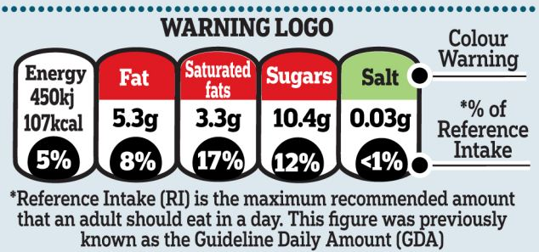
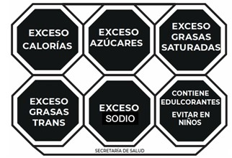
Extreme Warning Labels
UK warning labels appear red for food considered ‘bad’ for health
Mexican warning labels (hexagons) cover the waterfront of health and nutrition
Chilean warning labels (hexagons) for foods high in sugar and calories
Israeli warning labels for foods high in sugar, salt or fat
Notes:
Regulatory Authorities are making nutrition advisory labels mandatory on the front of food packages! The intention is tell consumers whether a product is healthy or unhealthy, includes ingredients of concern to public health.
These are examples on the market in the UK, Chile, and Israel.
Will these labels include a note on a products Carbon Footprint so consumers can make purchase decisions by comparing products on their sustainability metric?
When will these come to the US, Will Dairy be defined as HEALTHY?

Slide 47
How Do We Win?
Massive and sustained industry effort required to Keep Dairy Healthy!
Maintain dairy’s central position in the Dietary Guidelines
Notes:
Some may say that I am a broken record on the importance of health and wellness to the future of our dairy industry but I believe in technology and I know science takes time, and the public education on scientific issues is extremely difficult to achieve!
This will require a massive industry effort over a sustained period of time! I often say we need unexpected people saying enexpected positive things about dairy, in unexpected places.
The FDA is currently exploring the idea of defining healthy around fat and sodium. Don’t forget about the anti-animal activists!
One of our next major milestones will be to Maintain dairy’s central position in the DGAs

Slide 48
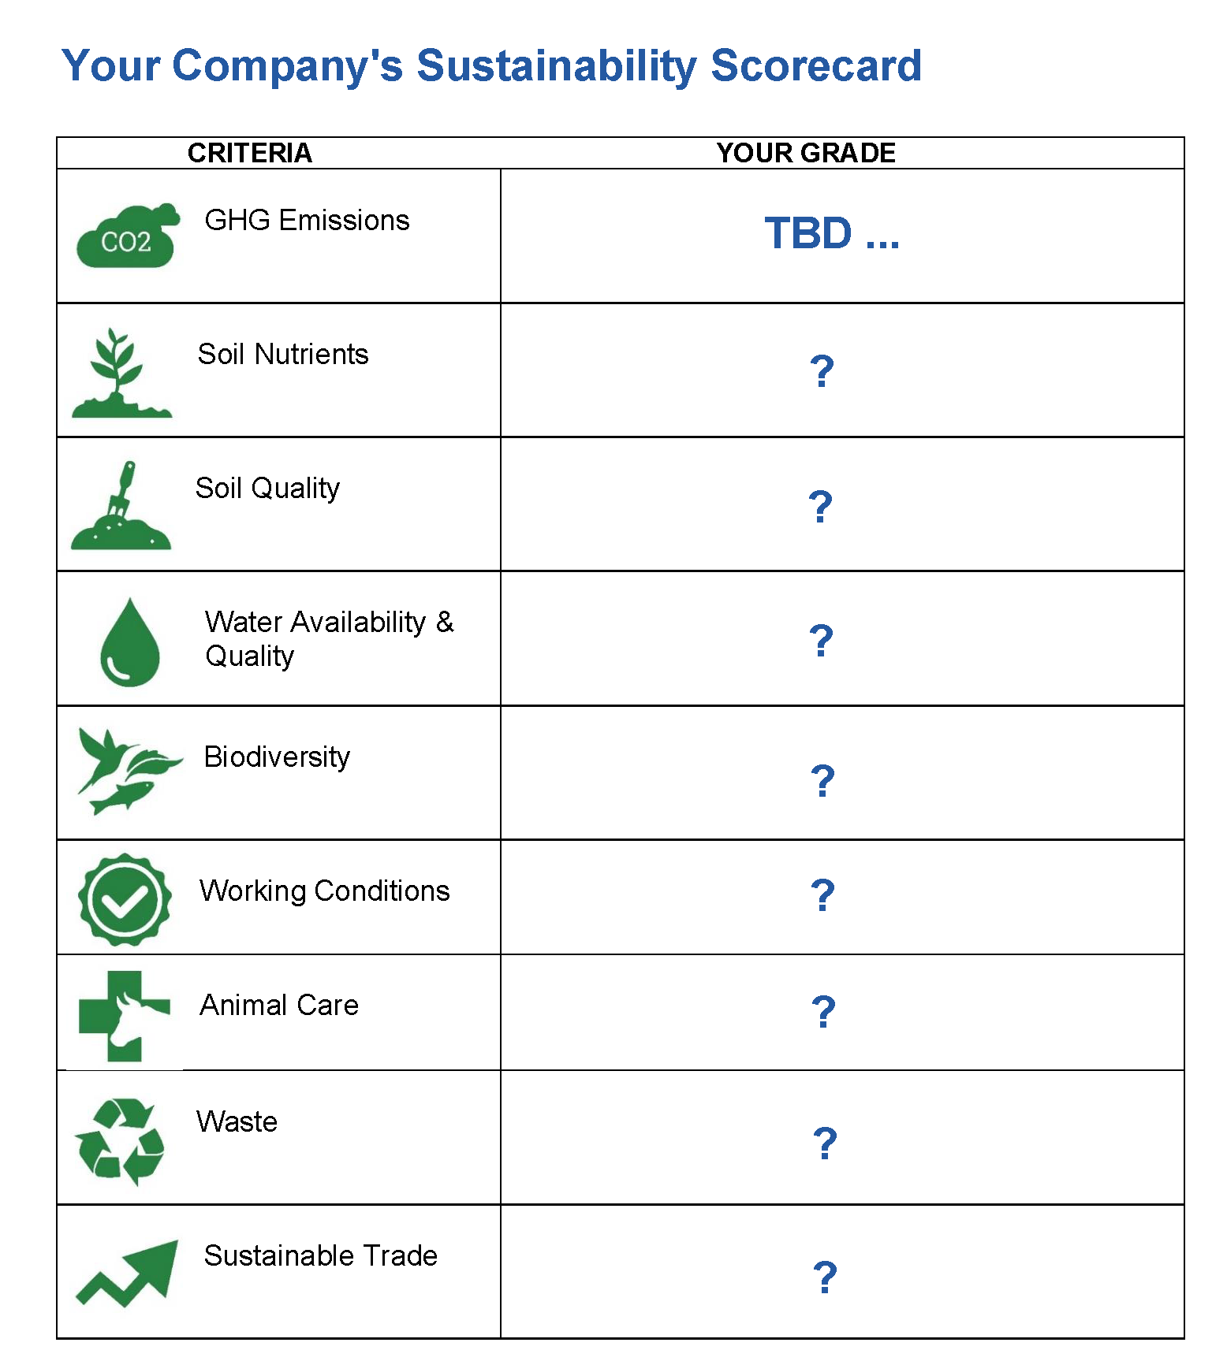
#2: No Sustainability
Metrics, No Sale?
It’s possible.
Are you ready?
Notes:
You evaluated every day on your financial performance. You will soon be evaluated on your sustainability performance.
We talked about the Environmental P&L. and SEC reporting of environmental risk.
It will also become a condition of sale….No metrics No Contract to sell!

Slide 49
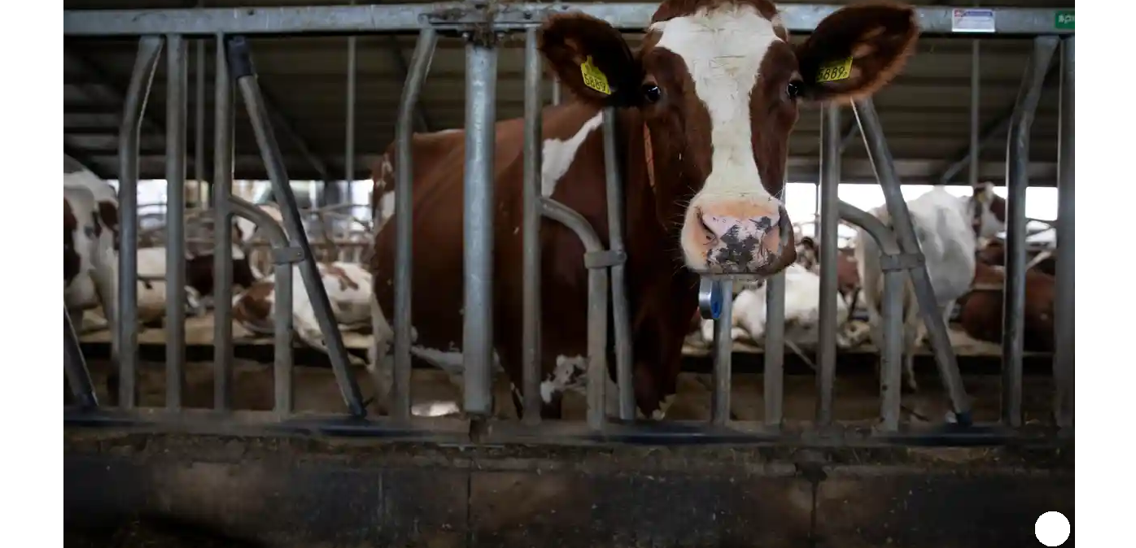
Netherlands Announces $33B Plan to Reduce Livestock
Notes:
Don’t forget the anti-animal activists.
This is a recent headline from NL.
Where will this appear next?

Slide 50
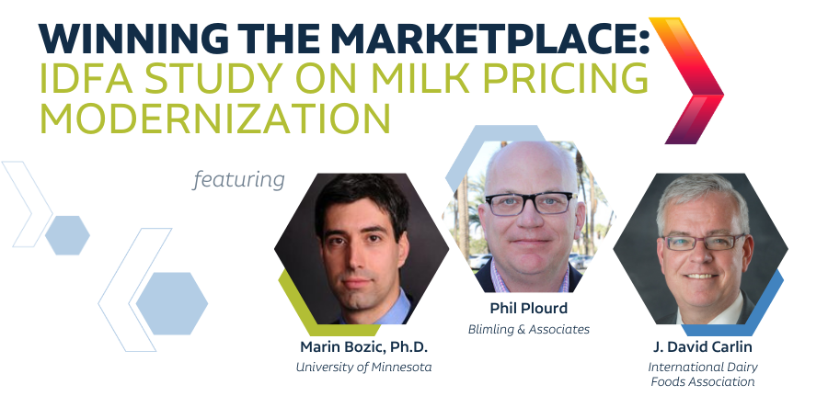
#3: Winning the Marketplace: Our Industry Will Align
Notes:
This industry is changing and changing rapidly.
We saw the controversy last year over the “Class 1 Mover” when cheese prices reached historic highs! The market was reacting the Pandemic but has since returned to more normal volatility. Almost every dairy group developed a different approach to address this issue.
Our EPC evaluated about 10 different approaches to address the concern. No support for any of the various proposal.
Some groups requested a Federal Ordre Hearing but USDA refused to convene a hearing.
WE Hired Dr Bozic and Blimling to study milk pricing issues by reviewing how our current FMMO system works in the current marketplace and how milk is priced in other countries.
EPC did want any recommendations….only a reporting of the facts and the Committee would develop recommendations for consideration by our Boards.

Slide 51
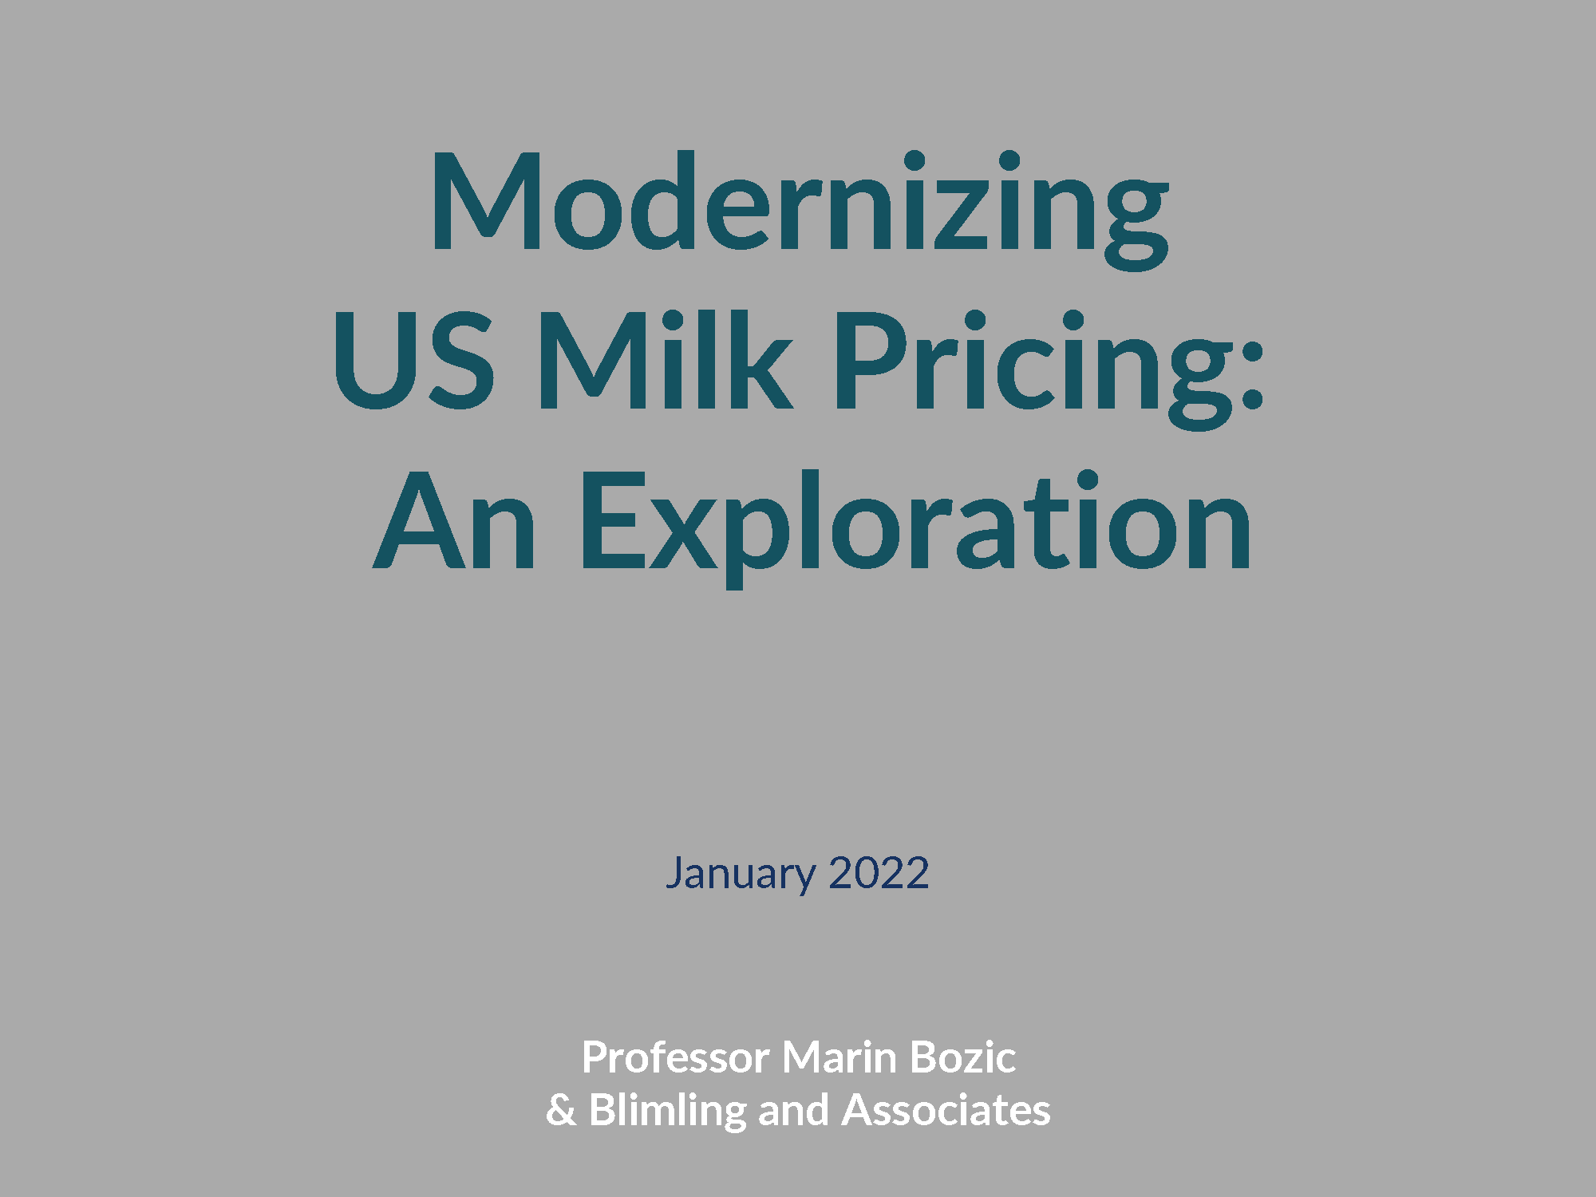
The Path Forward – Reform not Remove
Review of the facts
IDFA Economic Policy Committee (EPC): 70 members from all segments of dairy
Board action on recommendations
Will leadership come together?
Notes:
That study is completed and has been reviewed by the EPC and shared with our Boards.
The EPC has 70 members with extensive experience in milk pricing and the market dynamics across all sectors of the dairy industry.
If leadership will come forward with an industry recommendation………

Slide 52
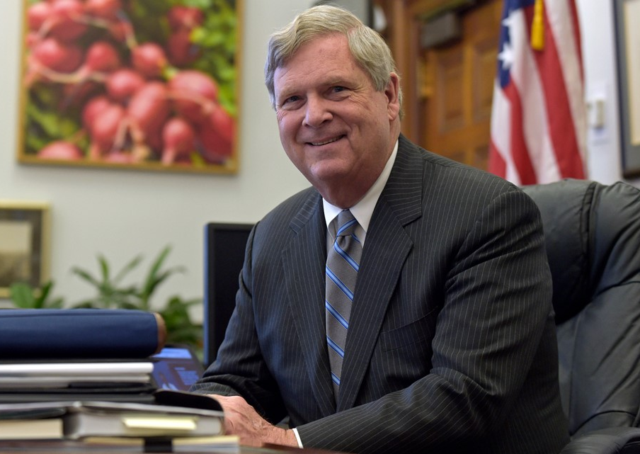
Opportunity
“Frankly, I think it’s up to the dairy industry itself to work through this process. … Dairy needs to get in a room and say, ‘Look, this is not a sustainable process. We’re not happy with the overall results here. How do we change it?’ … But if you all can do that and then come to the [USDA] and say, ‘This is what we think, collectively, will work,’ then I think you’d find the department very anxious to provide the help and assistance to get it done.”
- Secretary Vilsack, 12/20/21, Hoard’s Dairyman
Notes:
We will have a unique opportunity to end the age old fights within our industry and to Reform our current system so that it works well for the entire industry…. PRODUCERS & PROCESSORS
The USDA is taking the view that they are not going to do what the industry itself can’t do! They don’t want to pick winners and losers.

Slide 53
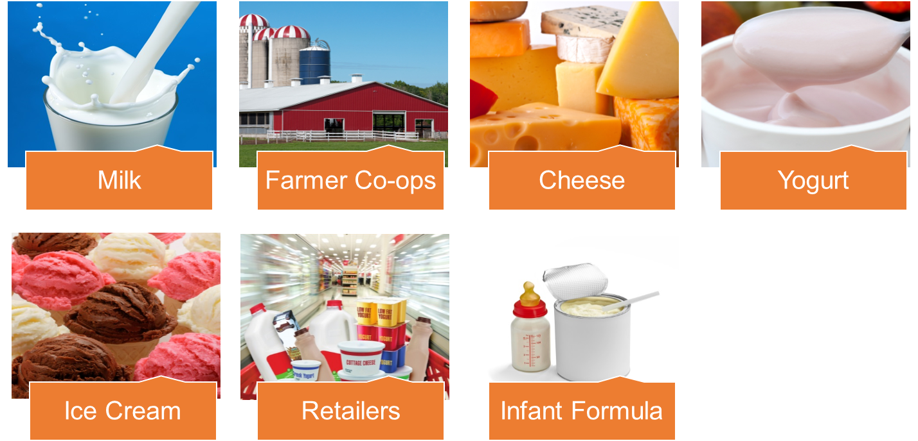
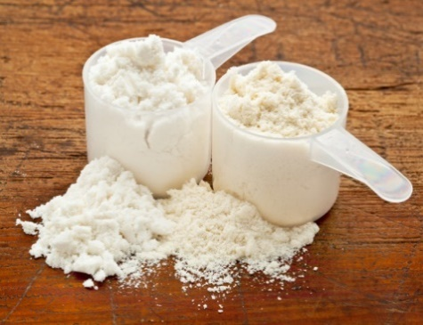
U.S. Will Become World’s Dominant Dairy Supplier
Dairy Ingredients
Notes:
If we can come together as an industry I truly believe the US will become the World’s Dominant Dairy Supplier!
We have many competitive advantages in our favor……open spaces, available water, access to capital and technology, excellent consumer base.

Slide 54
#4: People Will Determine Our Success
Notes:
People will Determine our Success! I have not doubt about this prediction. People will become more important than customers!
We will solve the supply chain issues, we will use technology to innovate and to increase our efficiency to sustainability produce safe and wholesome dairy products. But without People……None of this will happen!
We will have to compete and win for talent!
We have to make our dairy industry attractive for top talent and make it the place where our workers can make their dreams come true!

Slide 55
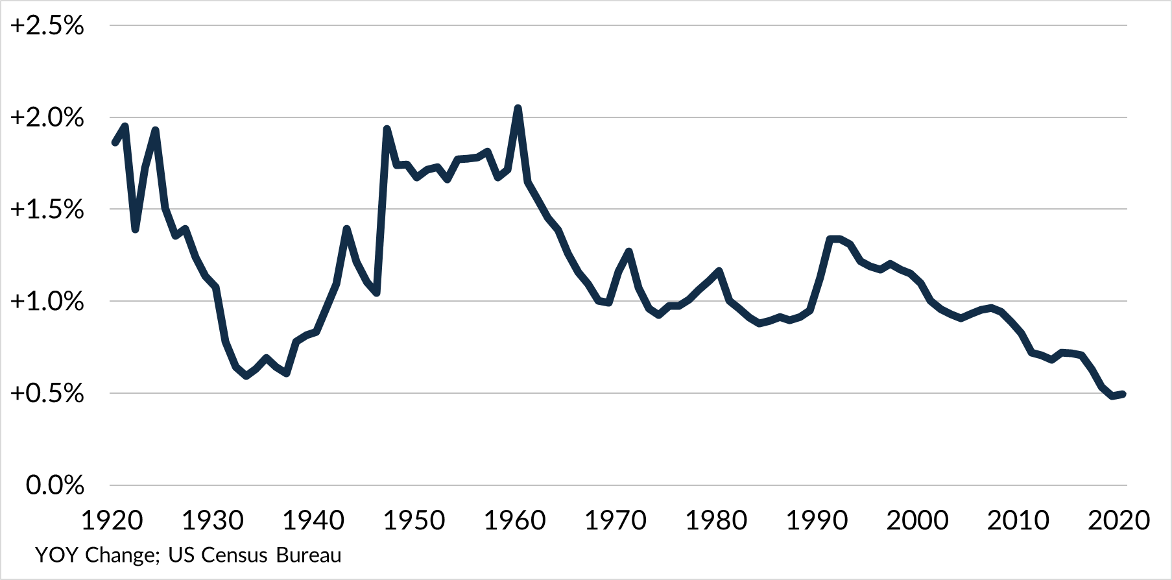
U.S. Population Growth Lowest in History
Notes:
So birthrates are declining in the US and in the developed world.
Death rates are rising as Baby Boomers grow older.
The US Population Growth was not only the lowest in history but it has been declining for last 10+ years!

Slide 56
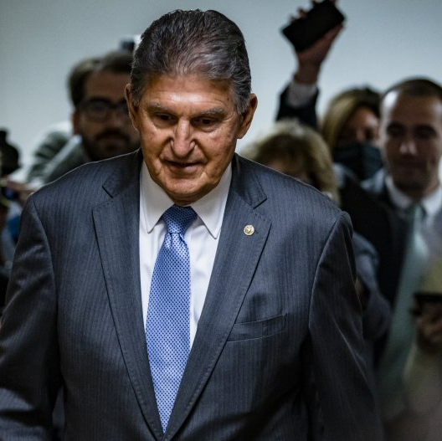
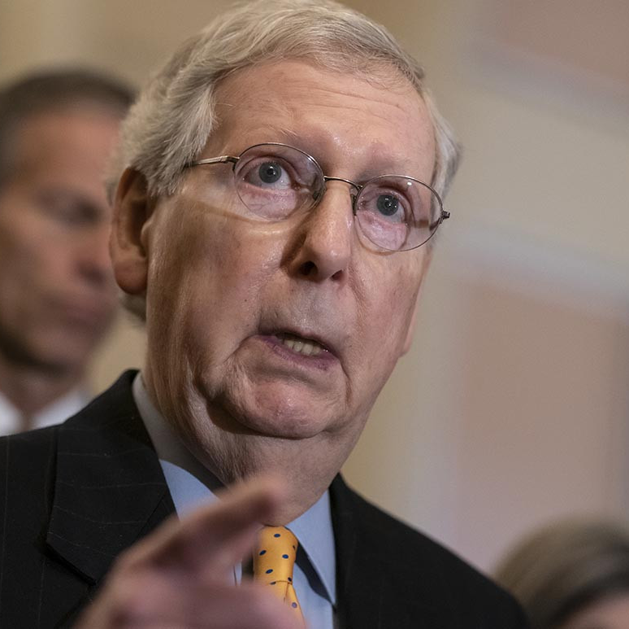
?
For the United States and U.S. Dairy to Compete, Immigration Reform Must Happen Within 5 Years
But Who Will Lead?
Notes:
So where do the PEOPLE come from?
We must pass immigration reform. I know some of you are saying that I am crazy but I truly believe this will happen and I am saying it will happen within the next 5 years. The lack of workers will drive real change!
Who will lead? It is likely to be someone we dont know or don’t expect!

Slide 57
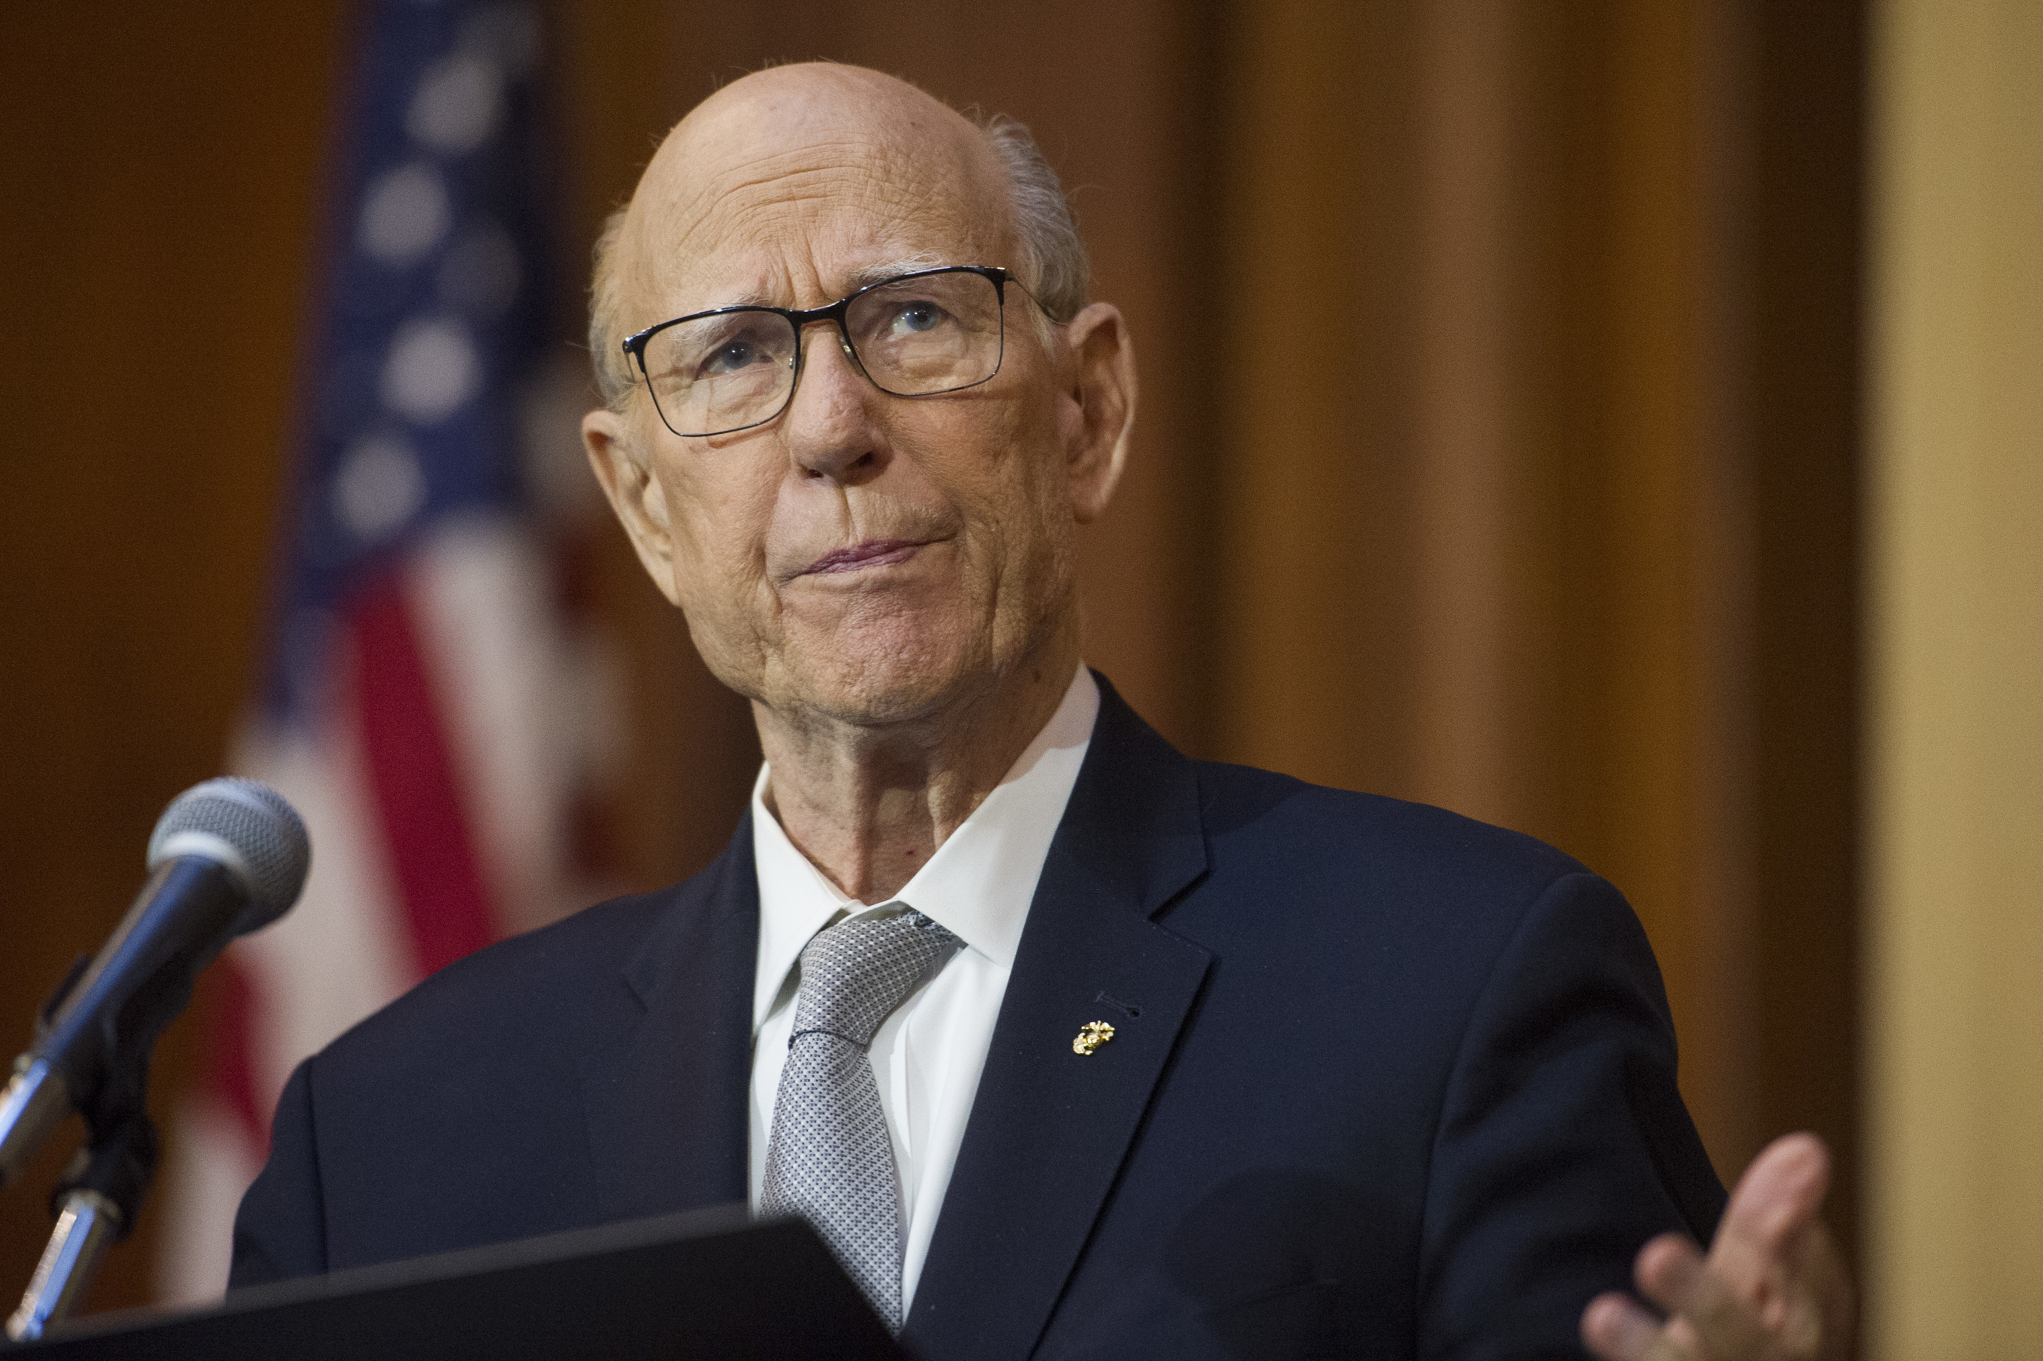
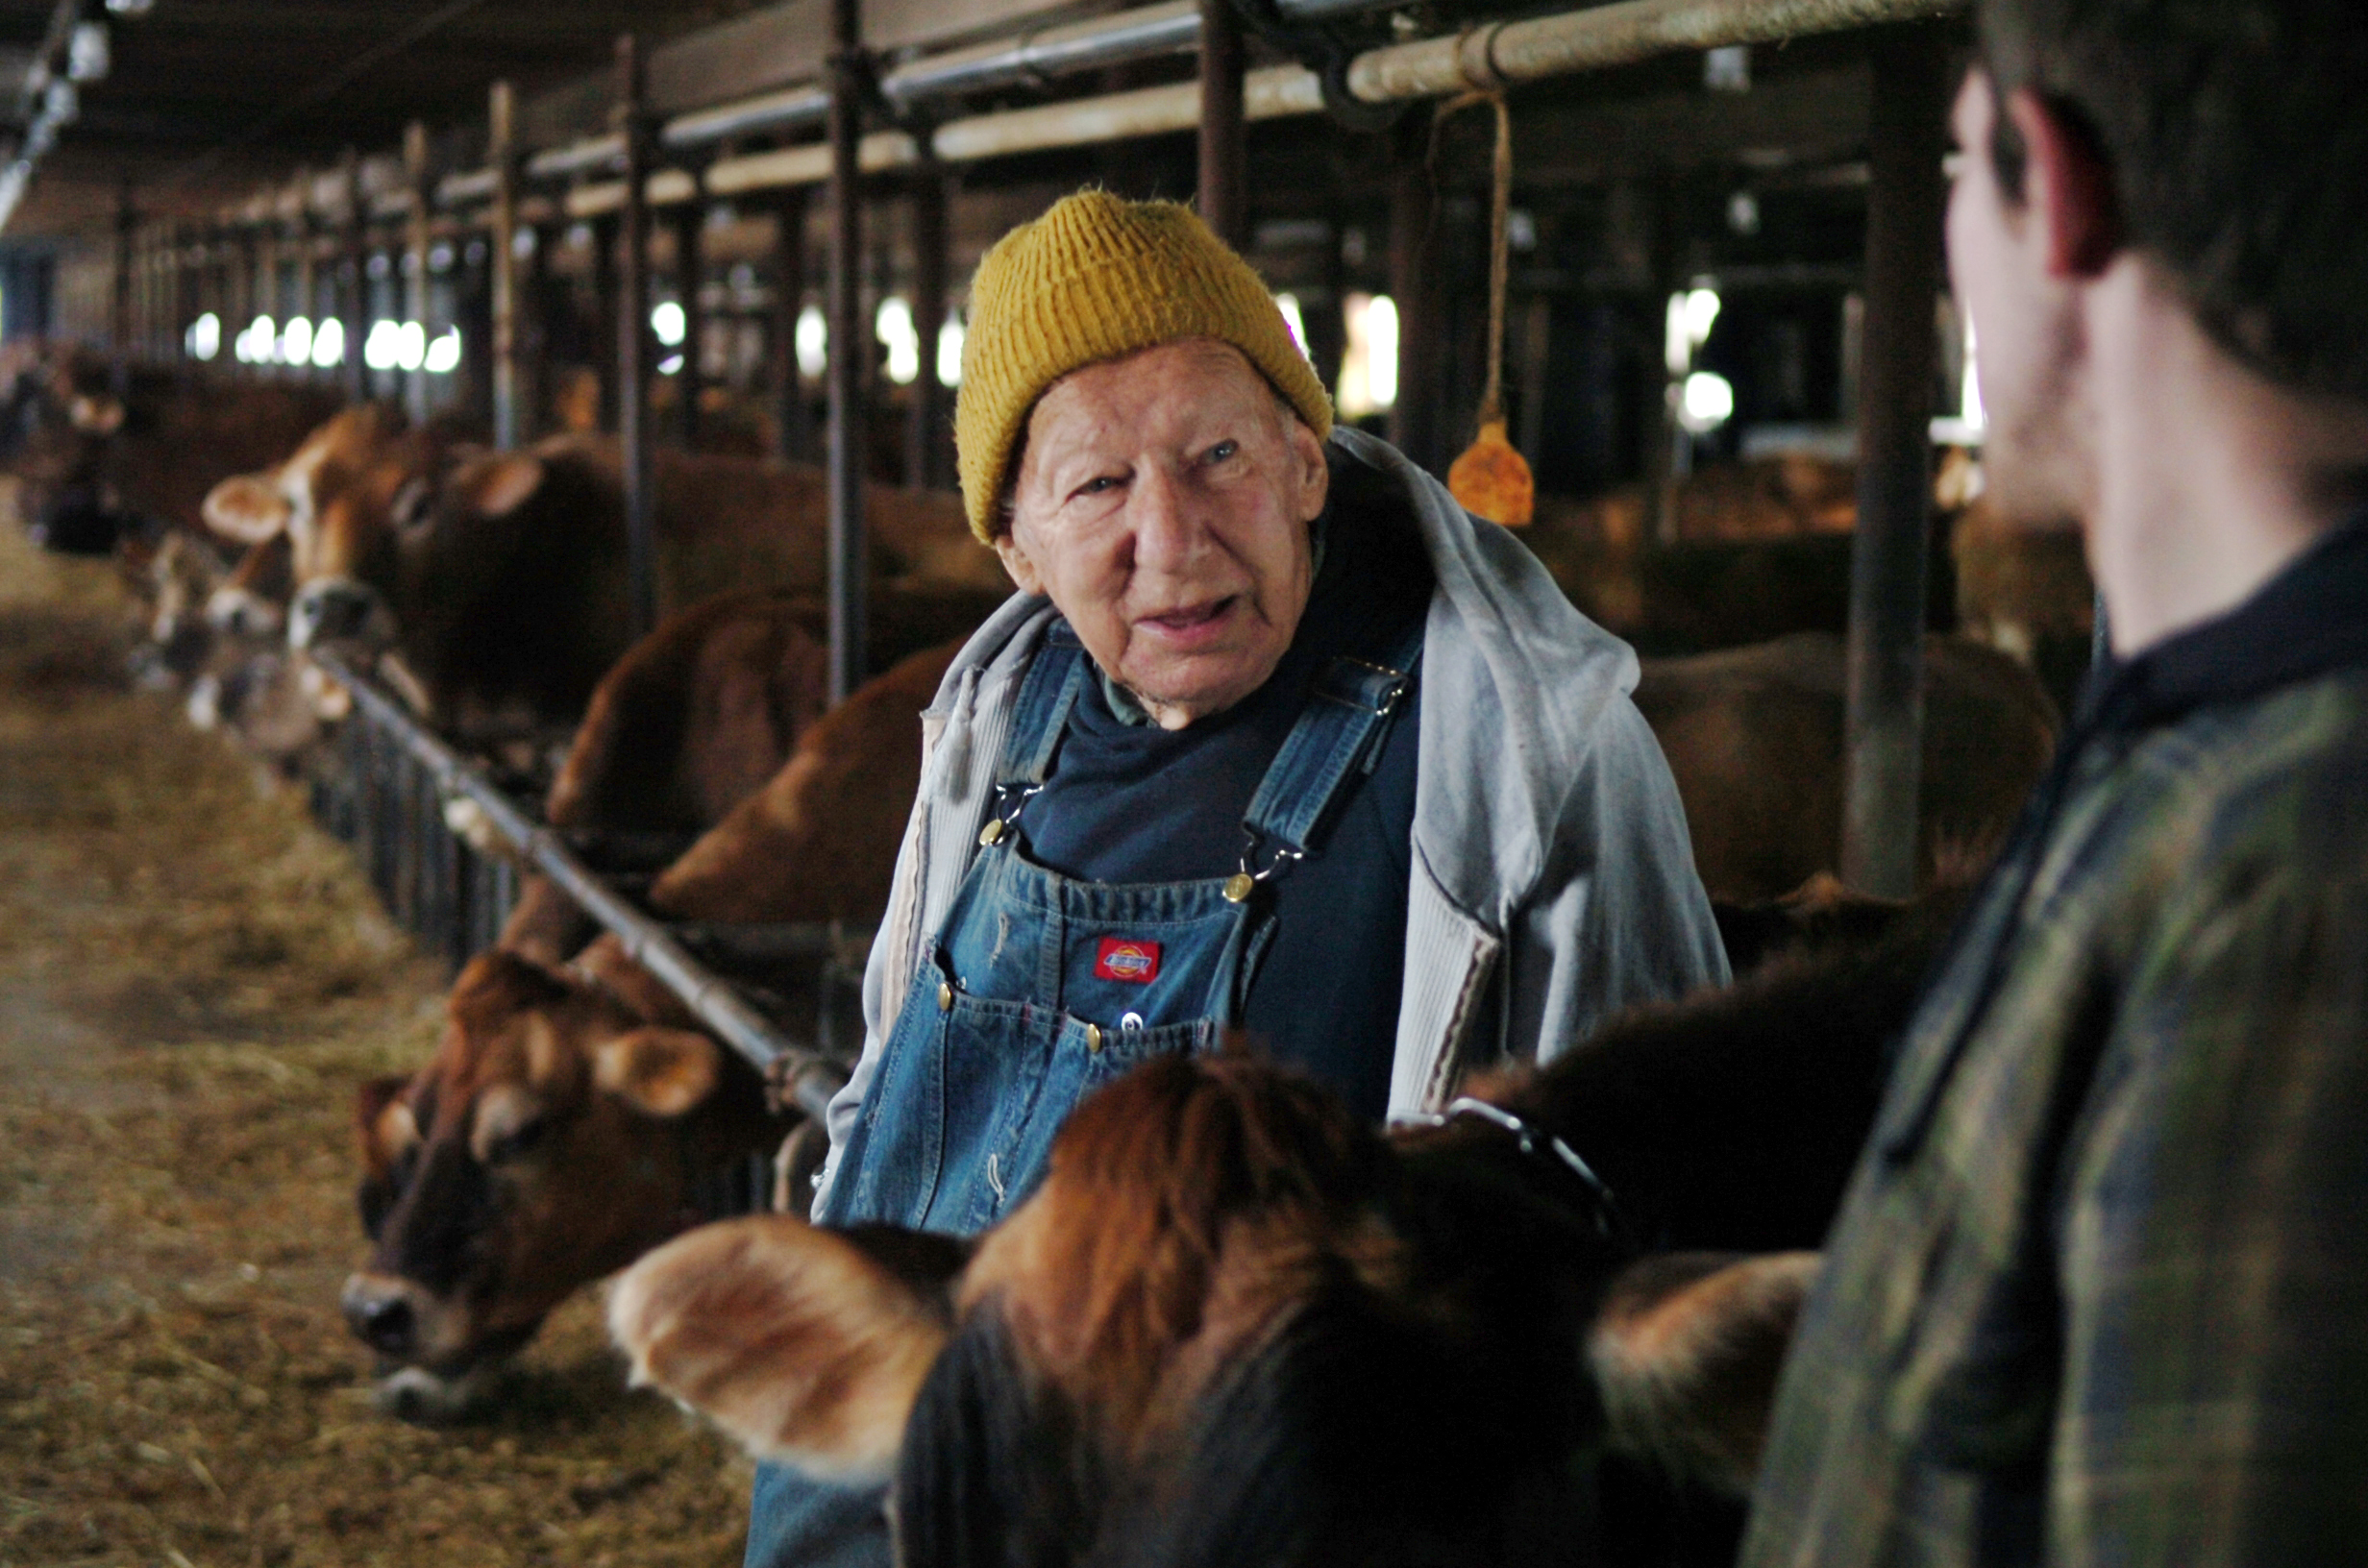
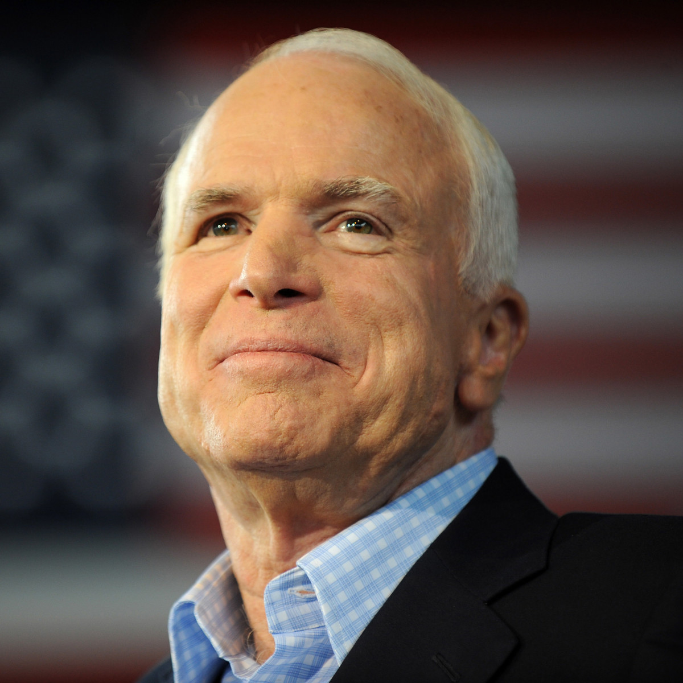
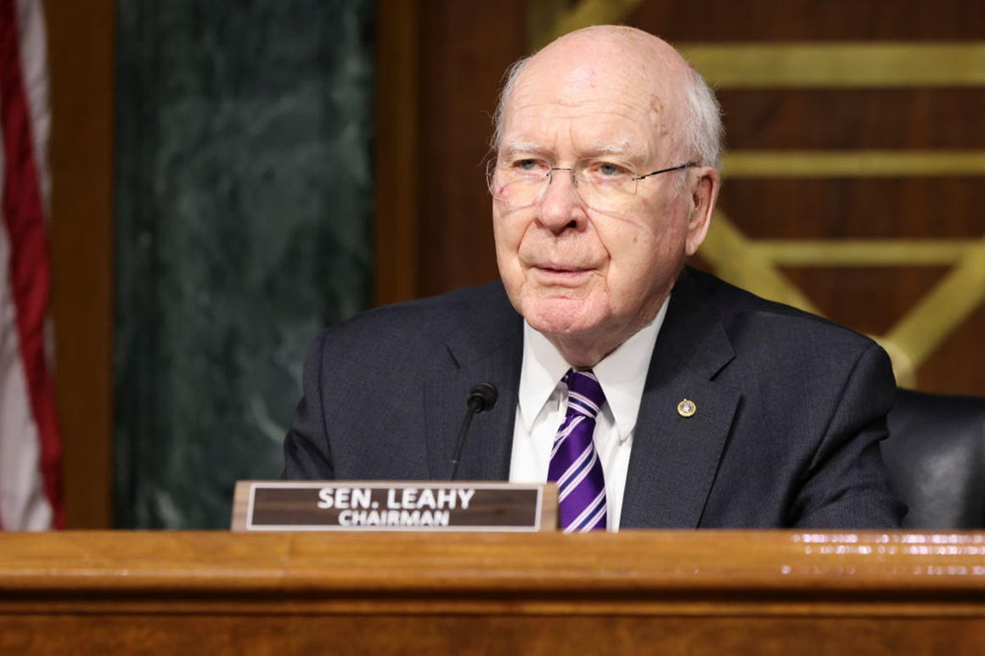
The Older Guard Is Leaving Us
Notes:
I say it is likely to be someone we don’t know or don’t expect because we KNOW the older guard is leaving us.
This is true on the policy front but also true across our dairy industry.
So again we come to the question of WHO will LEAD?

Slide 58
YOU Must Lead
Notes:
Together we are making a difference for dairy!
Thank you for all your support and engagement in my 5 years here at IDFA!

Slide 59
Let’s Stand United As One Dairy Industry
Notes:
Let’s stand United as one Dairy Industry and make the changes needed for our industry to be globally competitive… the dominant supplier to the world!

Slide 60
Together, we are making a Difference for Dairy
Thank You!
Notes:
Together we are making a difference for dairy!
Thank you for all your support and engagement in my 5 years here at IDFA!

Slide 62
BACK UP SLIDES

Slide 63
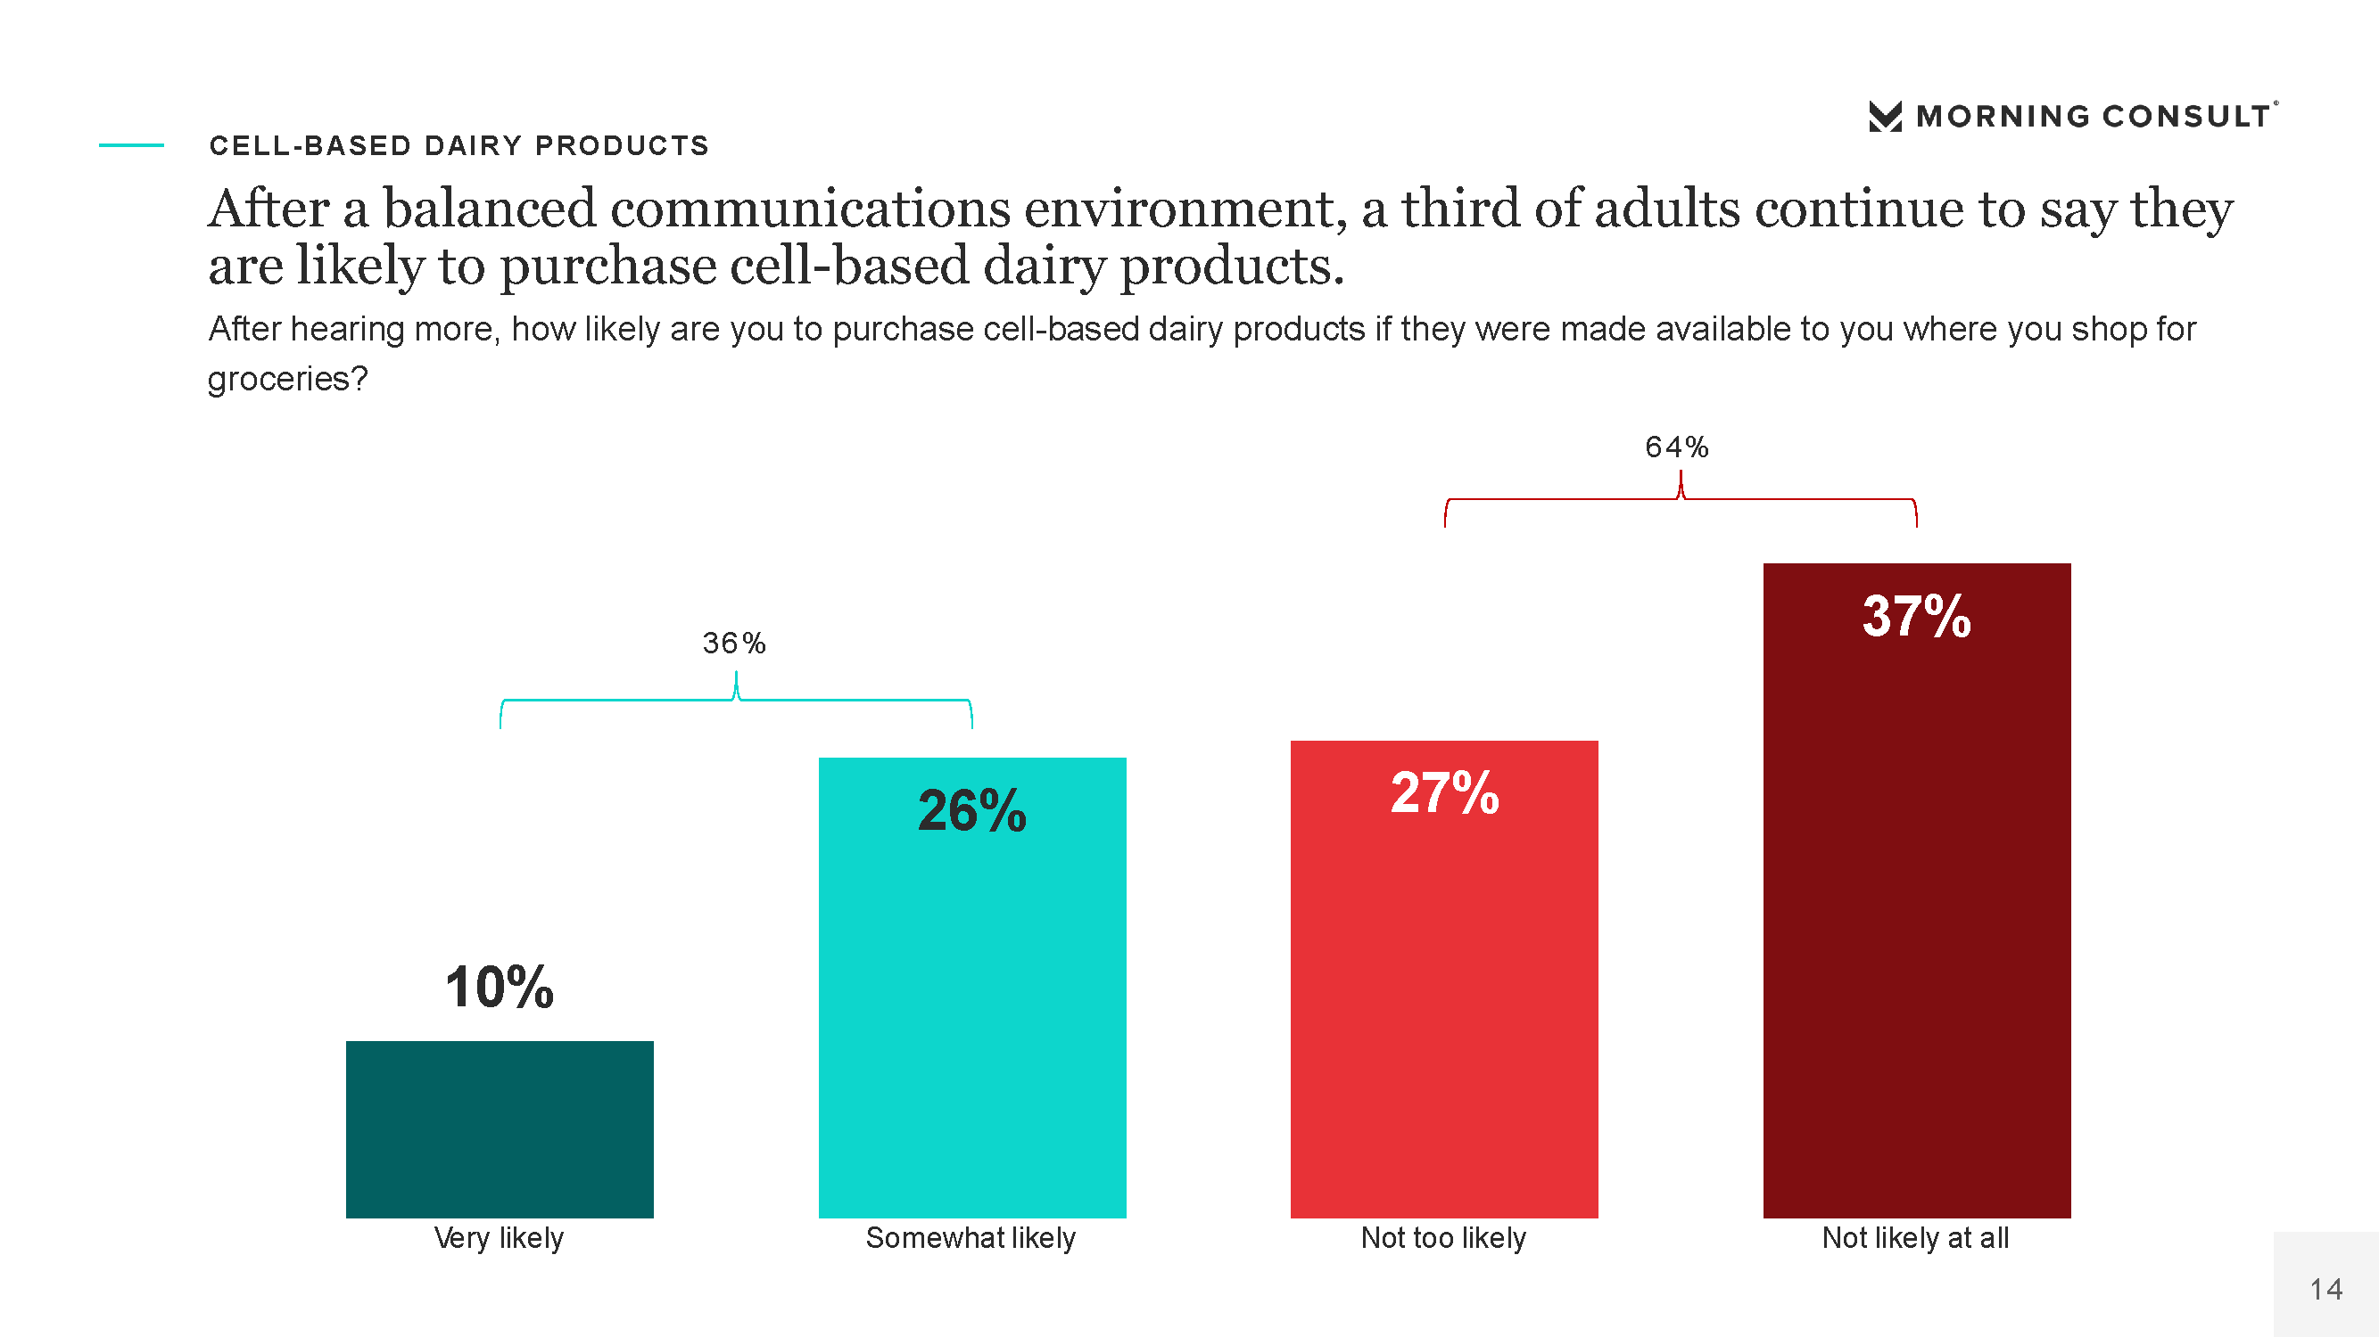

Slide 64
IDFA People Strategy
TBD Video – Video does not include Dairy Diversity Coalition

Slide 65
Is Our Glass Half Full … or Half Empty?
Wages rising
Demand up across category
Exports up around the world
Global milk production forecast to decline
U.S. milk prices expected to climb
Food price inflation beginning to ease
Companies investing in growth
Inflation & wholesale price increases well above historic rates
Gasoline, diesel & heating fuel costs up YTD
Supply chain issues, delays persist from farm to fork
Workforce challenges deepening as COVID re-intensifies

Slide 66
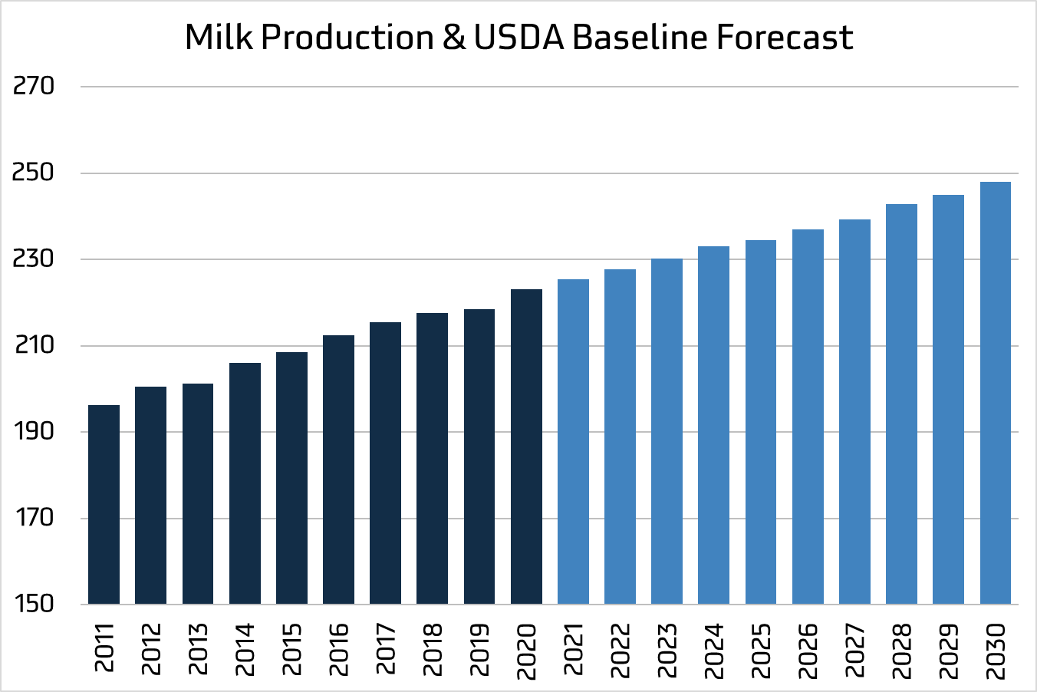
USDA: 25 Billion More Pounds By 2030
Our Milk Market Is Moving Overseas
Will We Boom?
Or Bust?

Slide 67
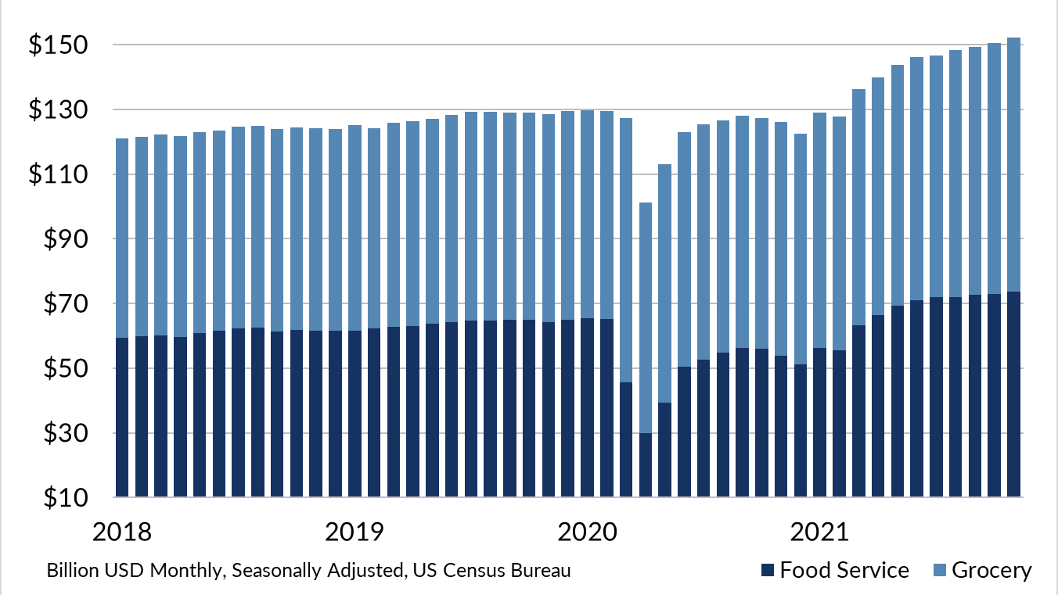
Restaurant & Grocery Sales Strongest in Years

Slide 68
Will We Boom … or Bust?
USDA: 25 Billion More Pounds By 2030
Our Milk Market Is Moving Overseas

Slide 69
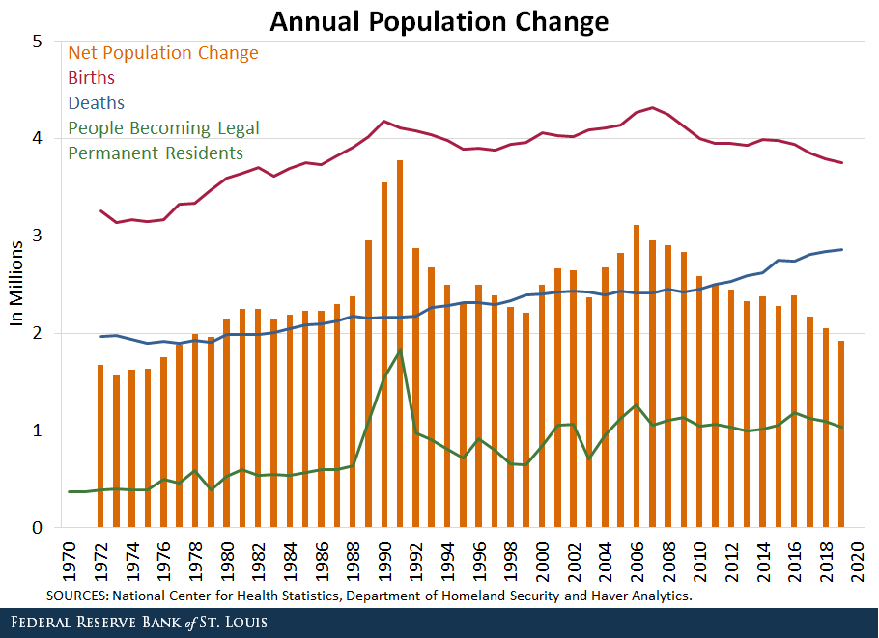

Slide 70
IDFA Dairy EP&L
TBD

Slide 71
People Will Determine our Success

